Slide 1
Topseller Quick Reference Guide
U.S. | November 2023

Slide 2
Lenovo Topseller - Notebooks

Slide 3
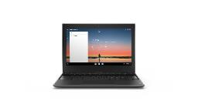
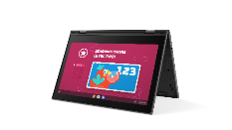
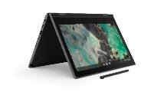
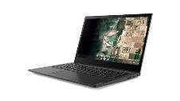
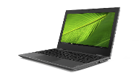




LENOVO TOPSELLERS - EDUCATION
100e Chromebook
300e Chromebook
500e Chromebook
14e Chromebook
100e Windows
300e Windows
14w Windows
ThinkPad 11e G5
ThinkPad 11e Yoga G6

Slide 4
Education Solutions - Chromebooks
100e Chromebook | $221 | $221
 | 82UY0000US (JSL) | 82W00001US (MTK4)
 | Intel Celeron N4500 | MTK MT8183
 | 4GB (soldered) | 4GB (soldered)
 | 32GB eMMC (soldered) | 32GB eMMC (soldered)
 | 11.6” HD TN AG | 11.6” HD TN AG
 | 720p HD Camera, 2x2 AC WLAN, BT | Front 720p HD Camera, 2x2 AC WLAN, BT
 | 47whr Battery | 47whr Battery
 | Chrome OS | Chrome OS
 | 1 Year Mail-in | 1 Year Mail-in
300e Chromebook | $270 | $299
 | 82W20003US (MTK4) | 82W20002US (MTK4)
 | MediaTek MT8186 | MediaTek MT8186
 | 4GB (soldered) | 4GB (soldered)
 | 32GB eMMC (soldered) | 32GB eMMC (soldered)
 | 11.6” HD IPS Touch | 11.6” HD IPS Touch
 | 720p HD camera w/ PS, 2x2 AC WLAN, BT | Front HD 720p camera + Rear 5.0MP, 2x2 AC WLAN, BT
 | 47Whr Battery | 47Whr Battery
 | Chrome OS | Chrome OS
 | 1 Year Mail-in | 1 Year Mail-in
500e Chromebook G2 | $299 | 295 | $344 | $368
 | 82JB0001US (JSL) | 82JB003XUS (JSL) | 82W40009US (IAN) | 82W4000AUS IAN
 | Intel Celeron N5100 | Intel Celeron N4500 | Intel N100 | Intel N100
 | 4GB (soldered) | 4GB (soldered) | 4GB (soldered) | 4GB (soldered)
 | 32GB eMMC (soldered) | 32GB eMMC (soldered) | 32GB eMMC (soldered) | 32GB eMMC (soldered)
 | 11.6” HD IPS Touch | 11.6” HD IPS Touch | 12.2" WUXGA Touch | 12.2" WUXGA Touch
 | World Facing Camera, pen, 2x2 AC WLAN, BT | Front HD 720p with Privacy Shutter | Front HD 720p with Privacy Shutter | Front HD 720p with Privacy Front HD 720p with Privacy Shutter + Rear 5.0MPShutter + Pen
 | 42Whr Battery | 42Whr Battery | 47Whr Battery | 47Whr Battery
 | Chrome OS | Chrome OS | Chrome OS | Chrome OS
 | 1 Year Mail-in | 1 Year Mail-in | 1 Year Mail-in | 1 Year Mail-in
14e Chromebook
$294 | $385
82W60000US (IAN) | 82W6000AUS (IAN)
Intel N100 | Intel N100
4GB (soldered) | 4GB (soldered)
32GB eMMC (soldered) | 32GB eMMC (soldered)
14" HD Non-Touch | 14" FHD Touch
HD 720p with Privacy Shutter | HD 720p with Privacy Shutter
57Whr Battery | 57Whr Battery
Chrome OS | Chrome OS
1 Year Mail-in | 1 Year Mail-in

Slide 5
Education Solutions – Windows
100e Windows G2 | $284
 | 81M80084US (GMLR)
 | Intel Celeron N4020
 | 4GB (soldered)
 | 128GB PCIe m.2 SSD
 | 11.6" HD
 | Camera, Intel 9560 2x2 AC WLAN, BT
 | 42Whr Battery
 | Win 11 STF entry
 | 1 Year Depot
14w G2 | $436
 | 82N80023US (PLK)
 | AMD 3015e
 | 4GB (soldered)
 | 128GB PCIe m.2 SSD
 | 14" FHD IPS Touch
 | Camera, non-intel WLAN, BT
 | 42Whr Battery
 | Win 11 STF entry
 | 1 Year Depot

Slide 6
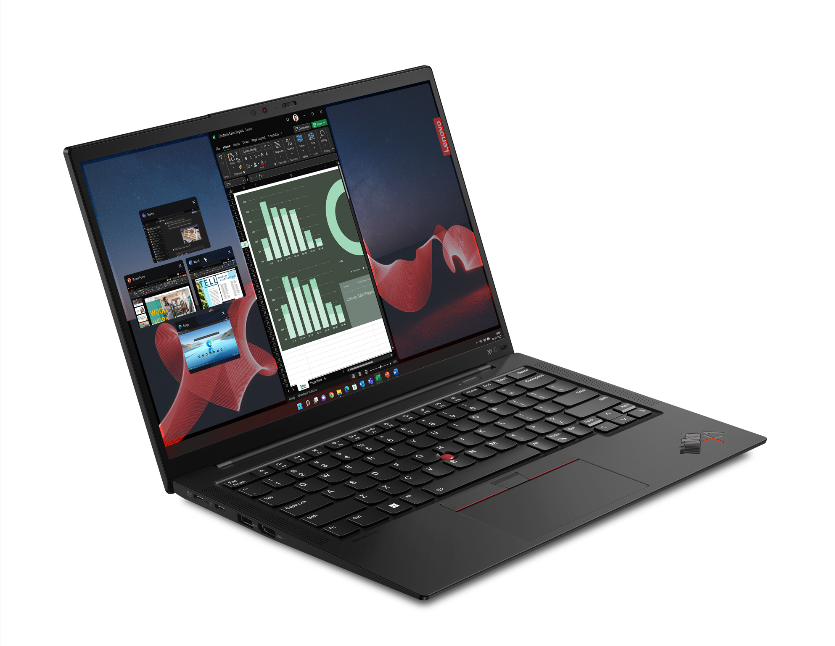
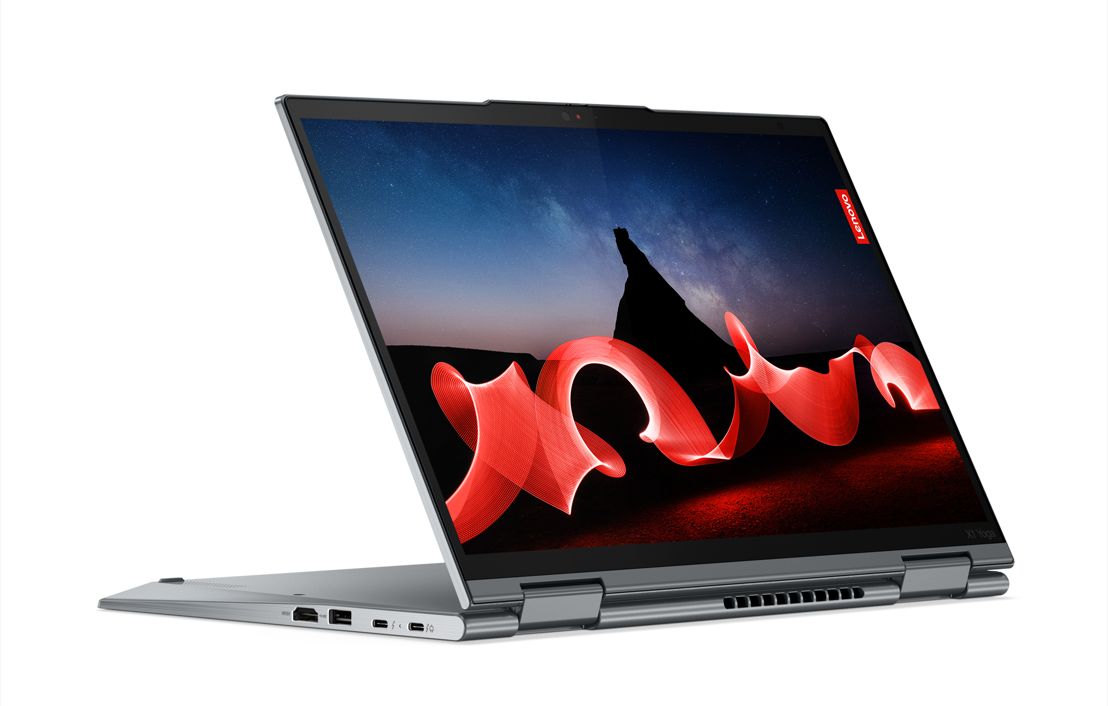
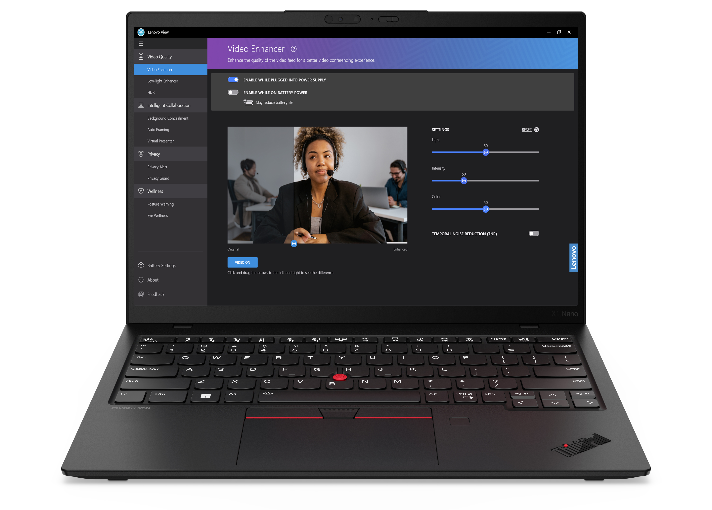
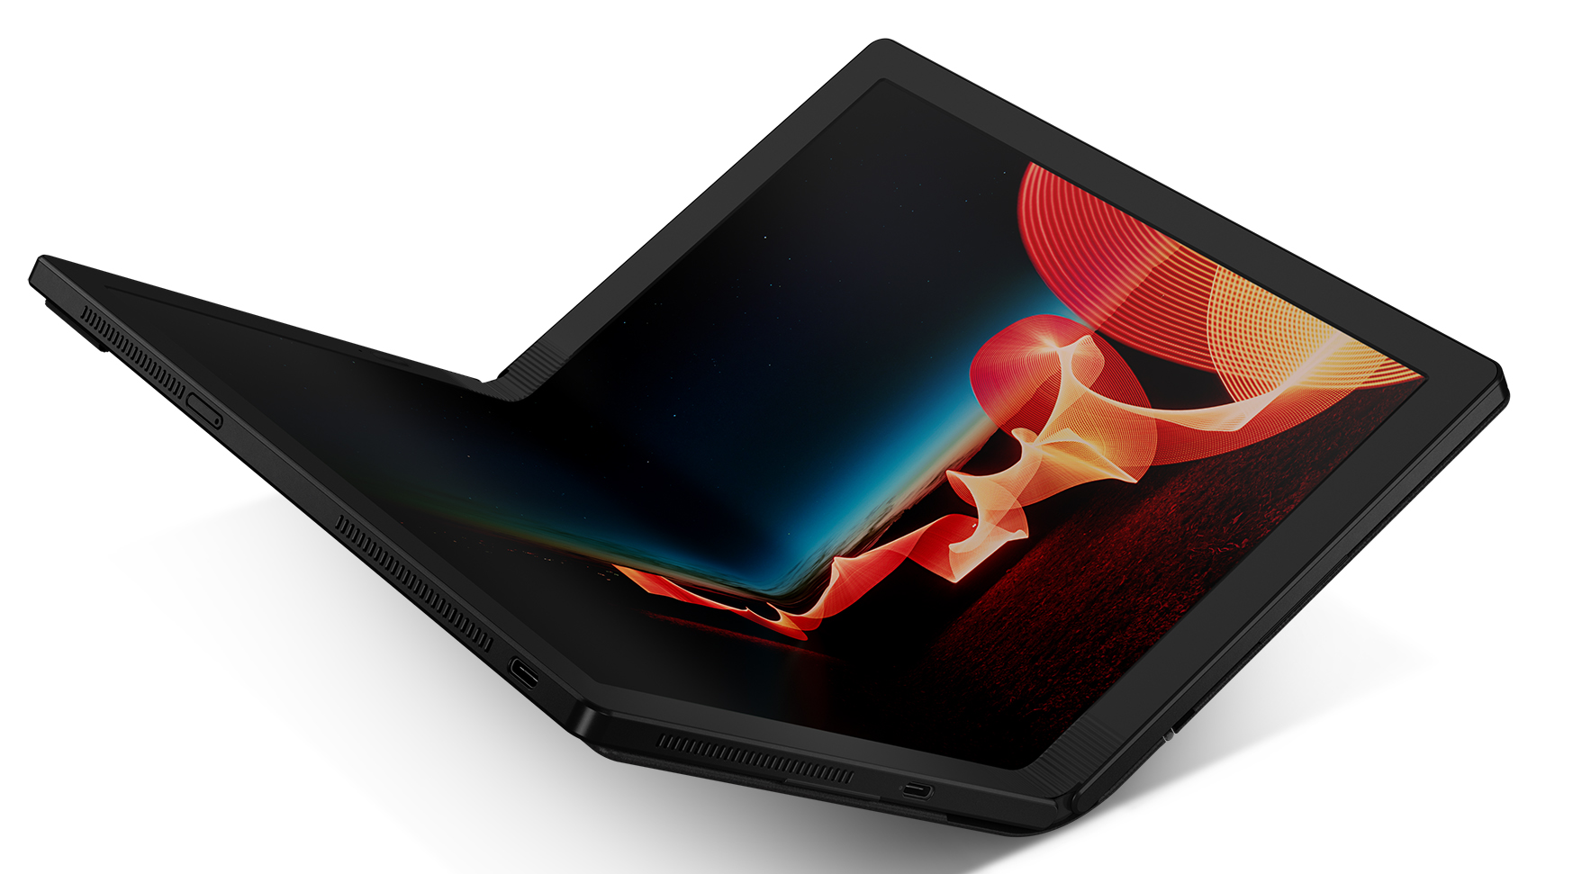
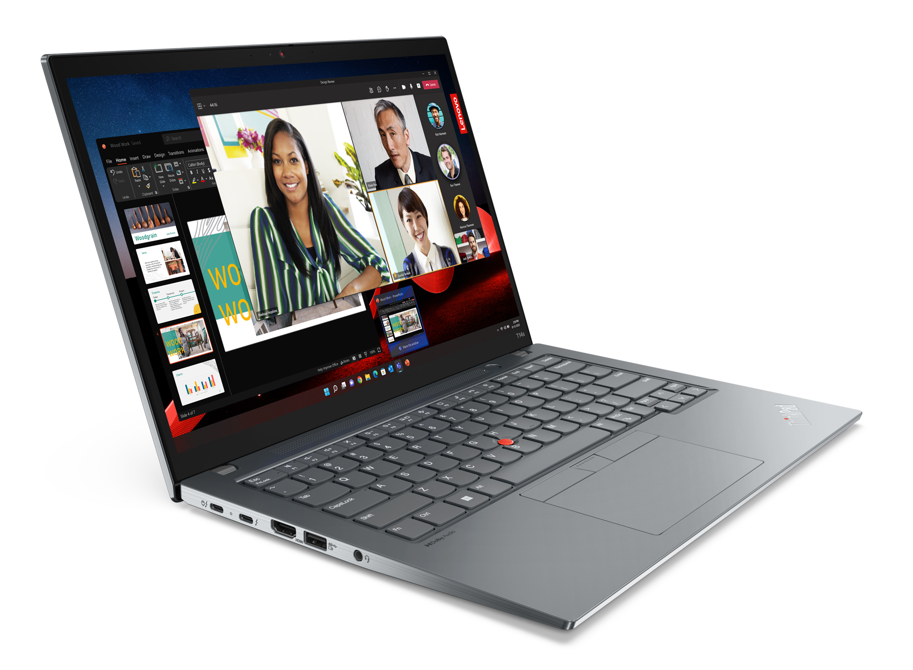
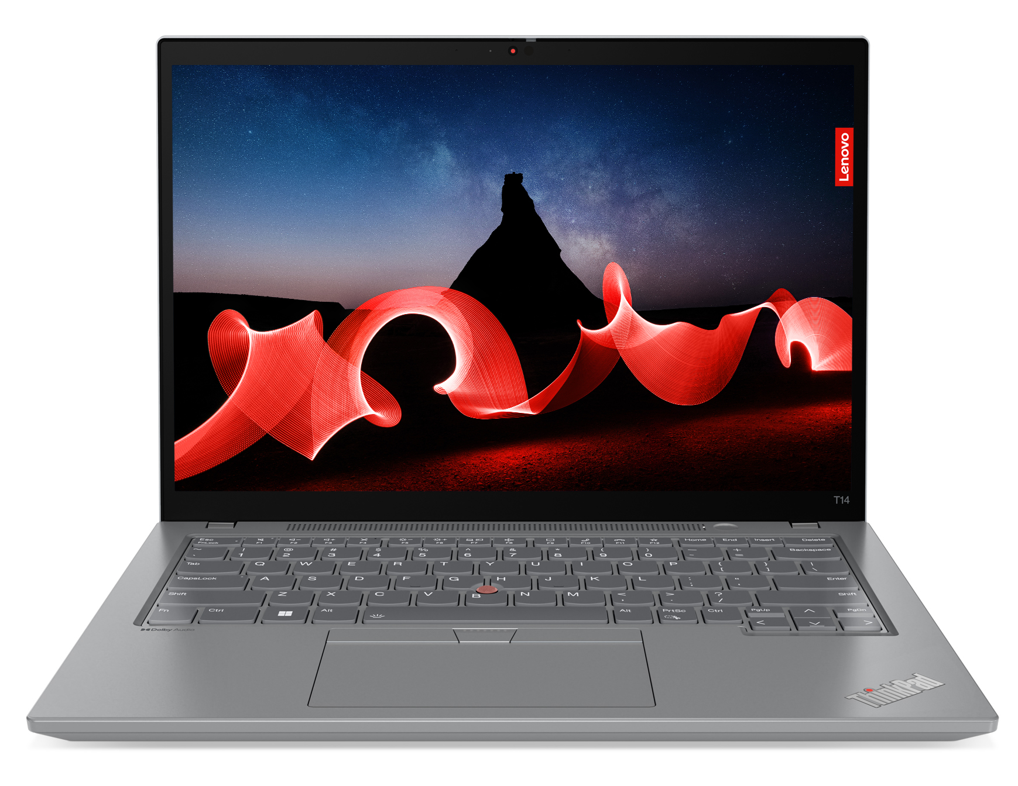
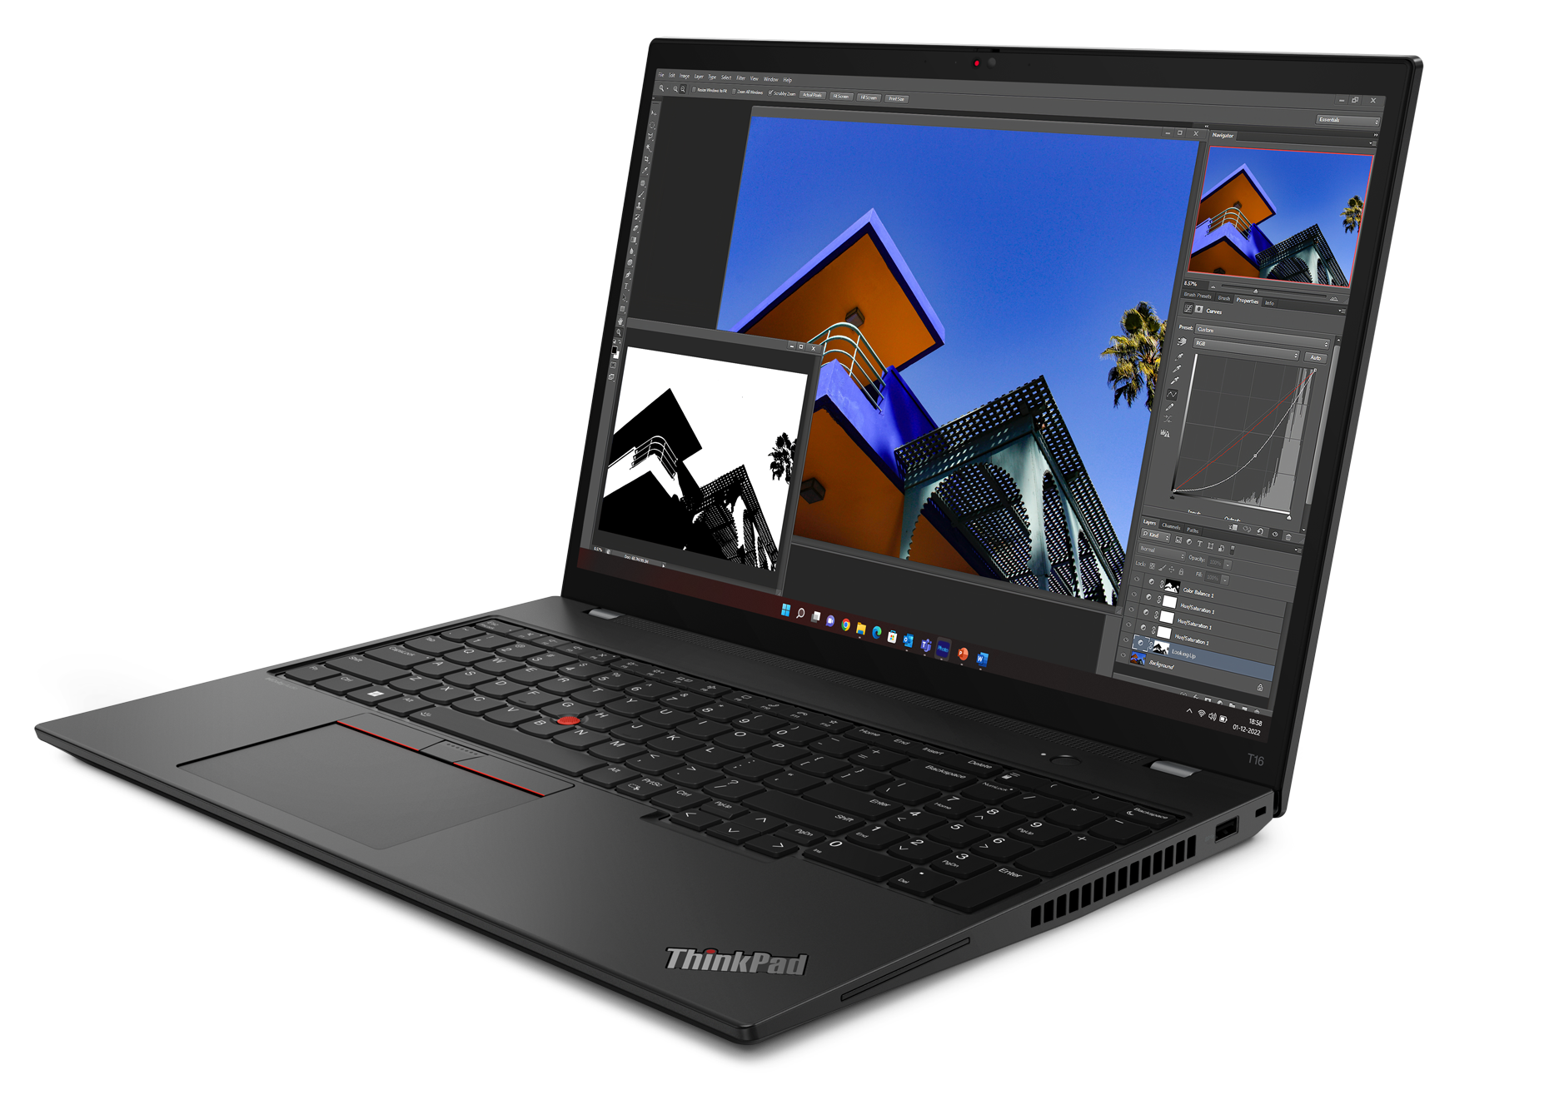
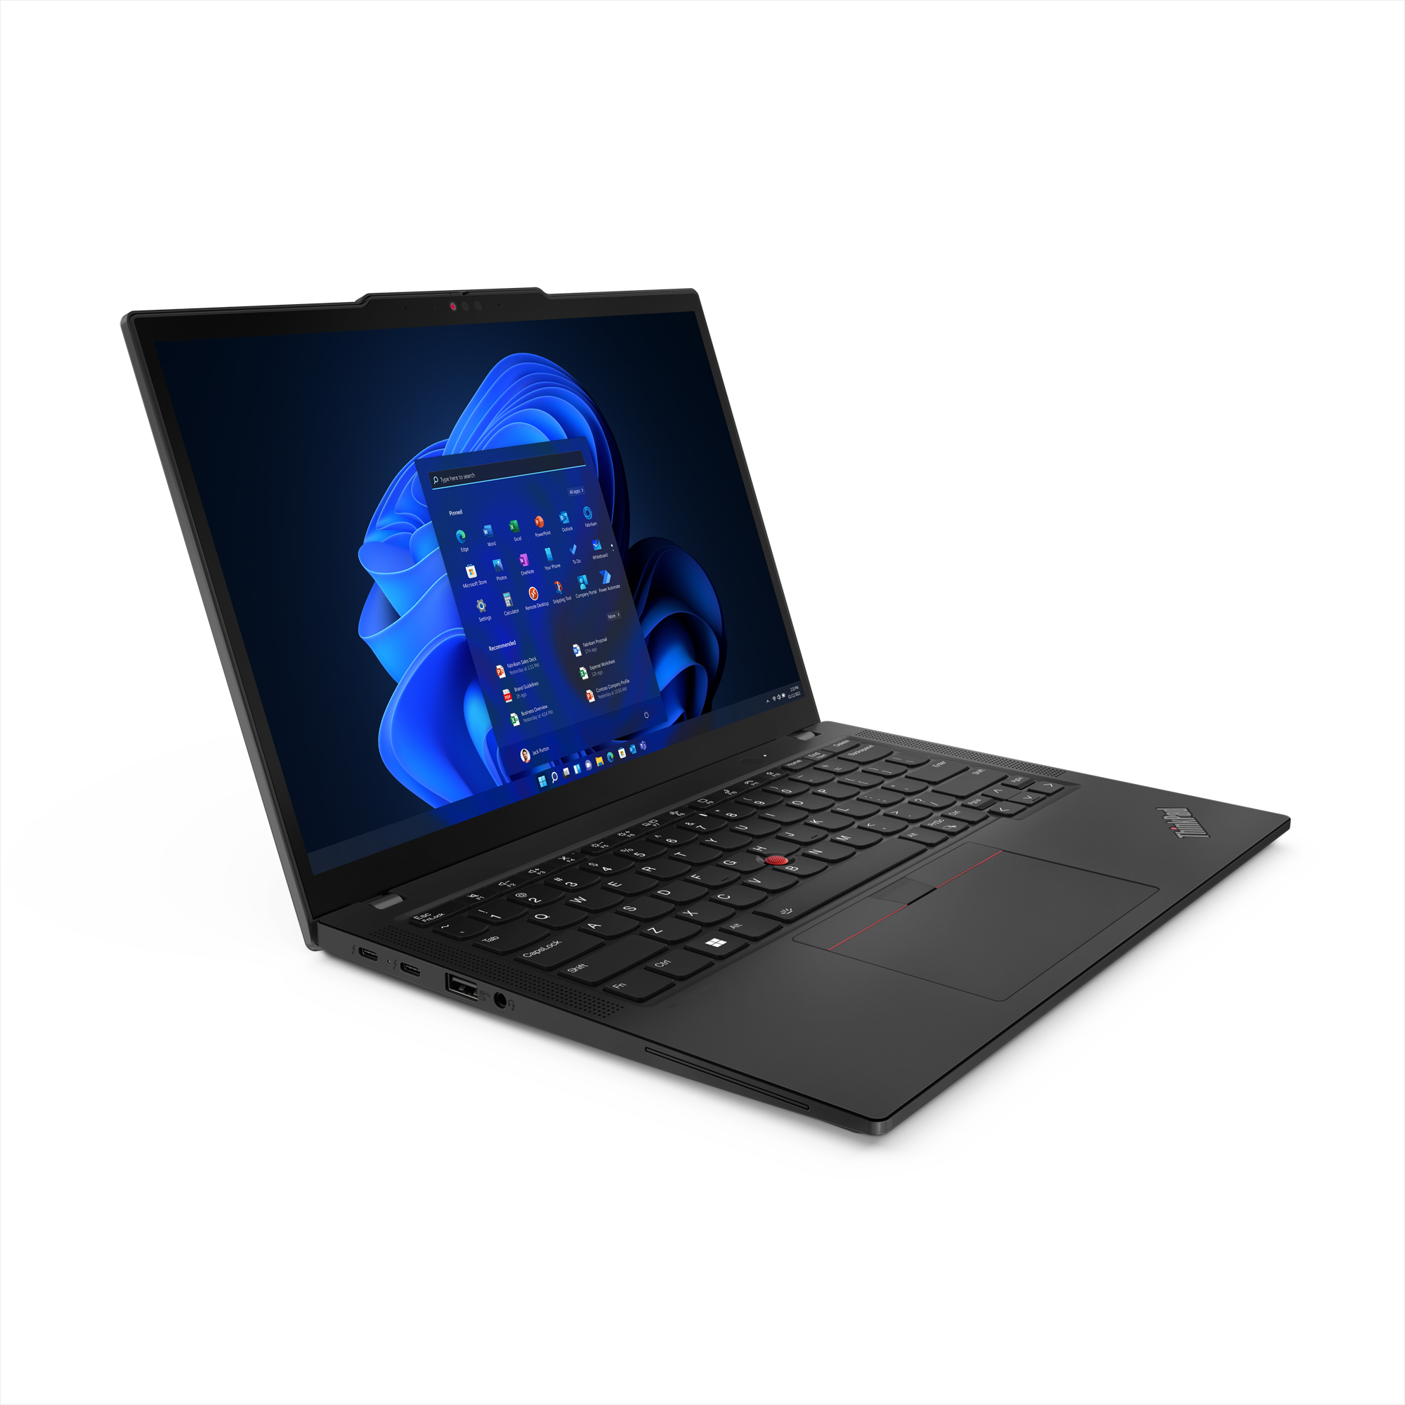
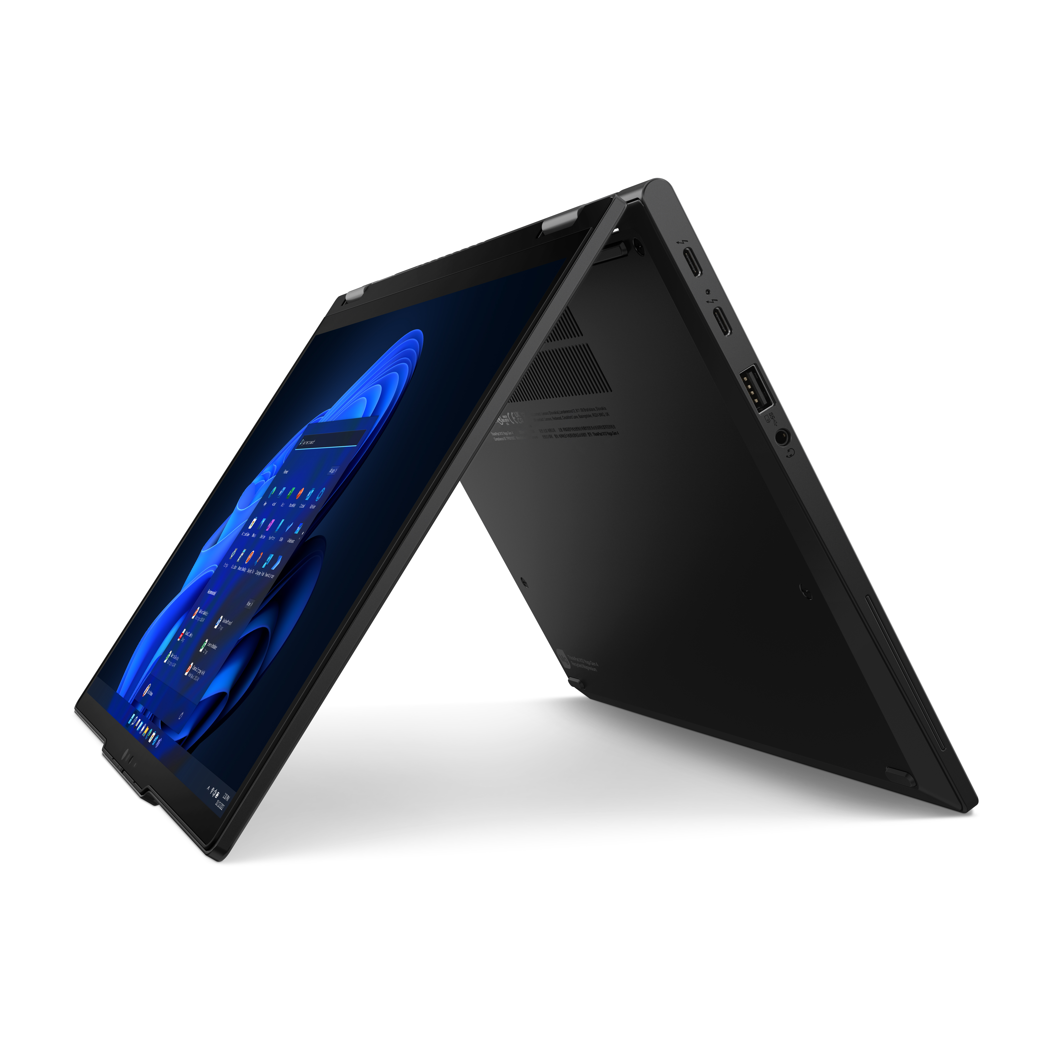
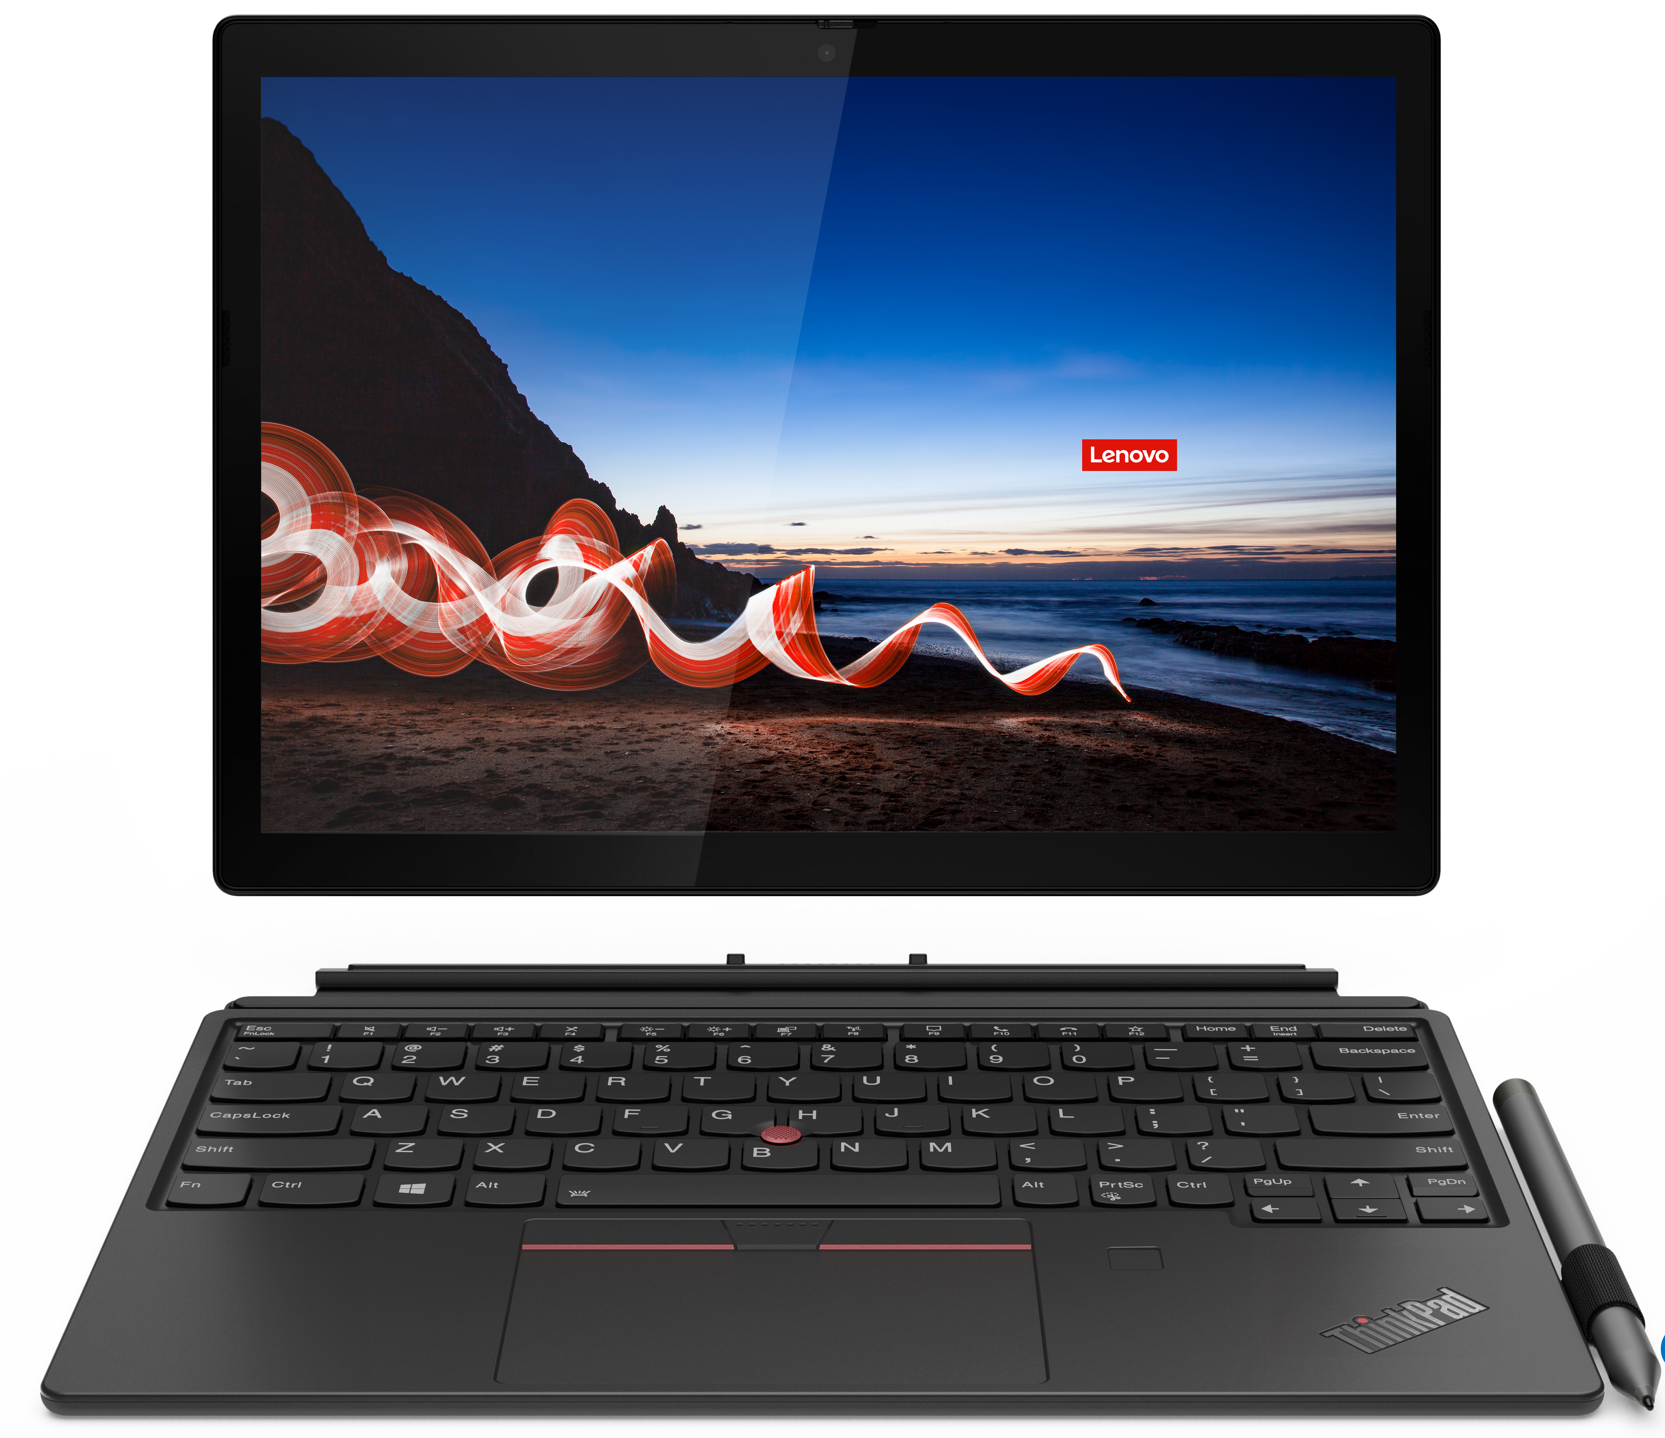
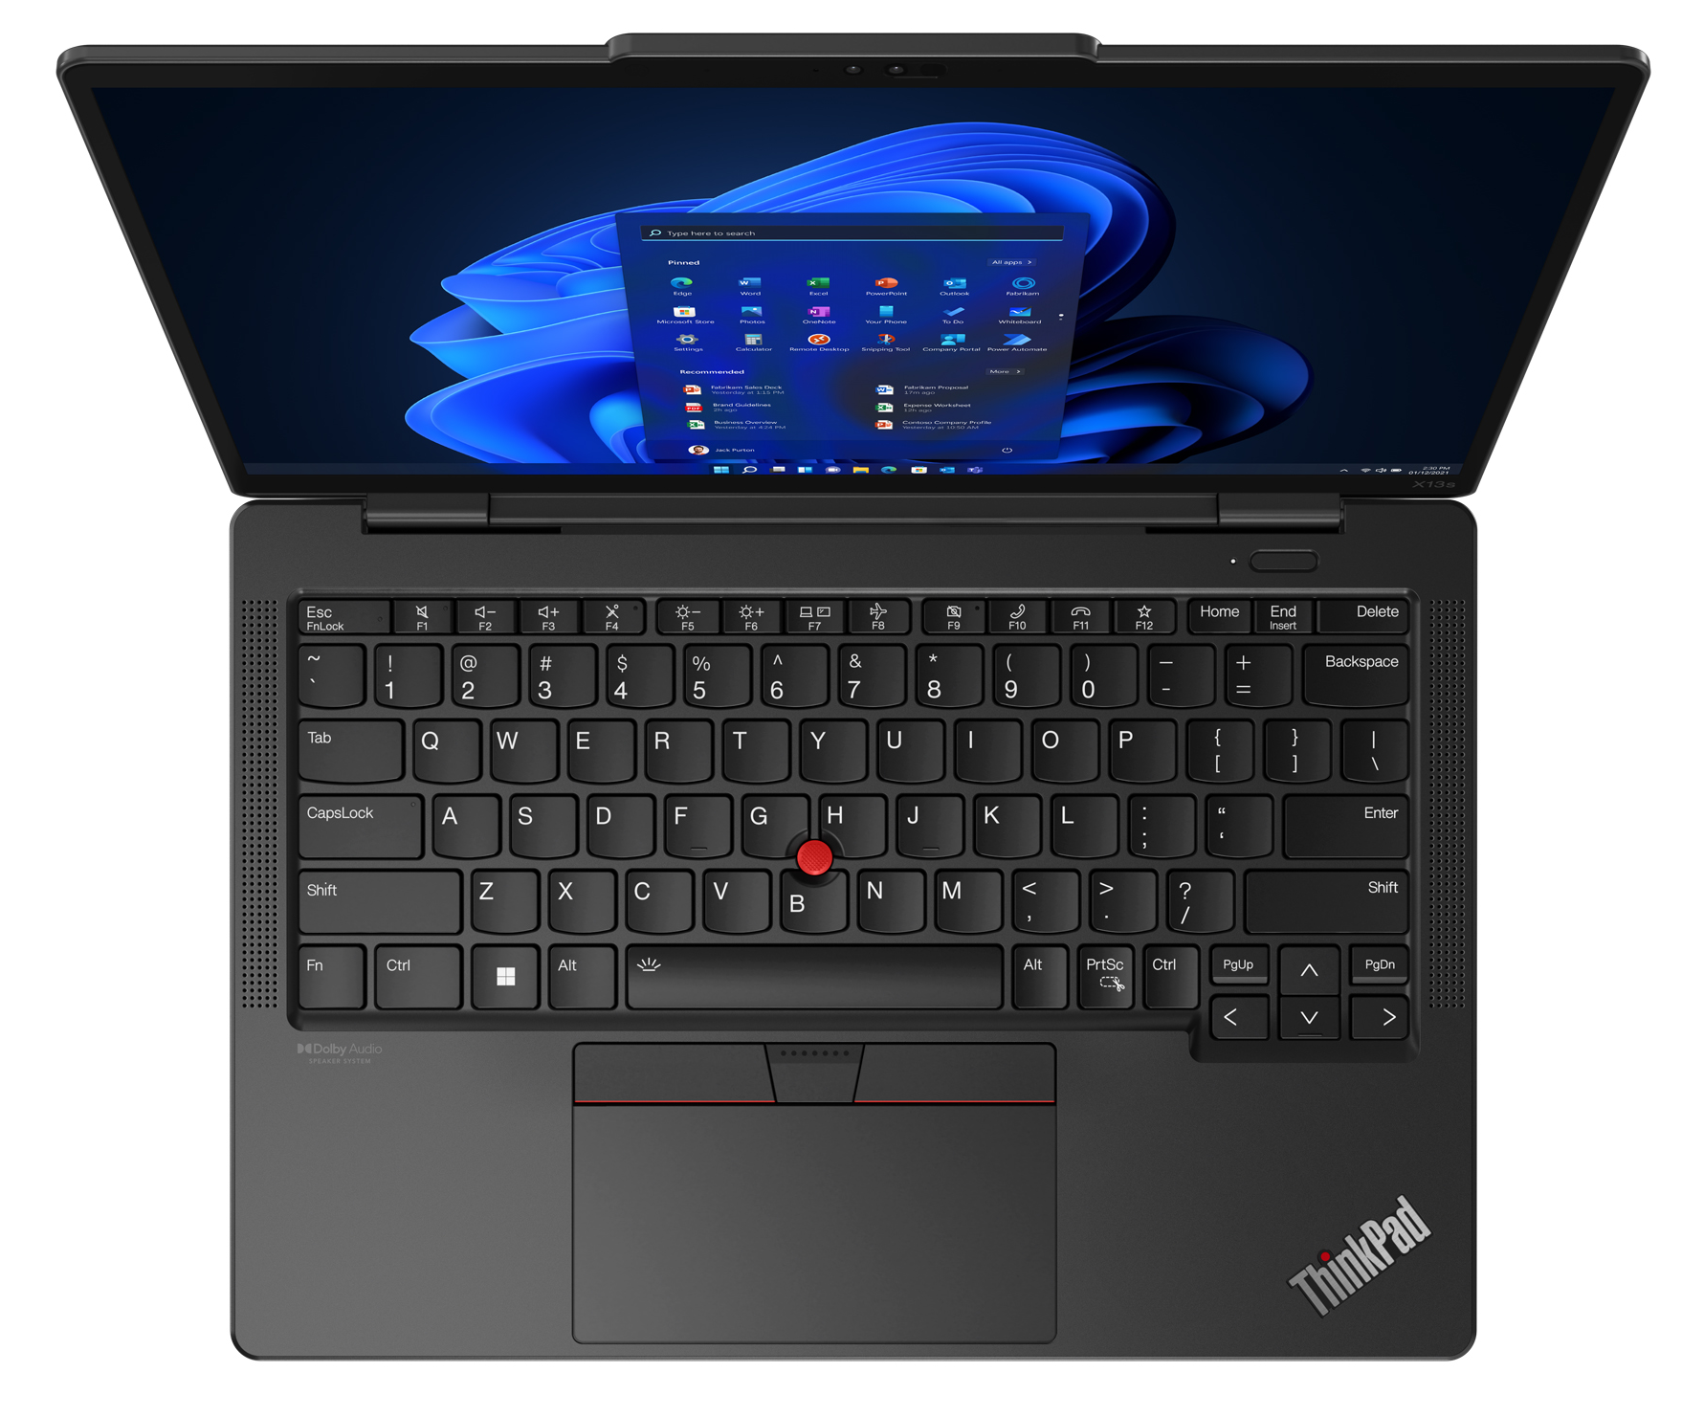
Premium ThinkPad
X1 Carbon 11th Gen
X1 Yoga 8th Gen
X1 Nano Gen 3
X1 Fold 16
T14s G4 (Intel/AMD)
T14 G4 (Intel/AMD)
T16 G2 (Intel/AMD)
X12 Detachable G1
X13 Yoga G3
X13s Gen 1
X13 G3 (Intel/AMD)

Slide 7
Premium ThinkPad T and X Series
T14 G4 (Intel) | $1443 | $1517 | $1599 | $1645 | $1747
 | 21HD0086US | 21HD0028US - Grey | 21HD0087US | 21HD002BUS - Grey | 21HD0088US
 | Core i5-1345U Vpro | Core i5-1335U | Core i5-1345U Vpro | Core i7-1355U | Core i7-1365U Vpro
 | 16GB | 16GB | 16GB | 16GB | 16GB
 | 256GB PCIe SSD | 512GB PCIe SSD | 512GB PCIe SSD | 512GB PCIe SSD | 512GB PCIe SSD
 | 14” FHD | 14" FHD Touch + IR Cam | 14" FHD Touch + IR Cam | 14" FHD Touch + IR Cam | 14" FHD Touch + IR Cam
 | Camera, Backlit Keyboard, FPR, 2x2 + BT5.2, BT | Camera, Backlit Keyboard, FPR, 2x2 + BT5.2, BT | Camera, Backlit Keyboard, FPR, 2x2 + BT5.2, BT | Camera, Backlit Keyboard, FPR, 2x2 + BT5.2, BT | Camera, Backlit Keyboard, FPR, 2x2 + BT5.2, BT
 | Integrated 39Wh | Integrated 39Wh | Integrated 39Wh | Integrated 39Wh | Integrated 39Wh
 | Windows 11 Pro | Windows 11 Pro | Windows 11 Pro | Windows 11 Pro | Windows 11 Pro
 | 3 Year Depot | 3 Year Depot | 3 Year Depot | 3 Year Depot | 3 Year Depot
T14s G4 (Intel) | $1471 | $1710 | $1875
 |  | Rebate: $50
 | 21F6001CUS - Grey | 21F6001BUS - Grey | 21F6001HUS - Grey
 | Core i5-1335U | Core i7-1355U | Core i7-1365U Vpro
 | 16GB (soldered) | 16GB (soldered) | 16GB (soldered)
 | 256GB PCIe SSD | 512GB PCIe SSD | 512GB PCIe SSD
 | 14” FHD | 14” FHD | 14” FHD Touch
 | Camera, Backlit Keyboard, FPR, 2x2 AX WLAN, BT | Camera, Backlit Keyboard, FPR, 2x2 AX WLAN, BT | Camera, Backlit Keyboard, FPR, 2x2 AX WLAN, BT
 | Integrated 57Wh | Integrated 57Wh | Integrated 57Wh
 | Windows 11 Pro | Windows 11 Pro | Windows 11 Pro
 | 3 Year Depot | 3 Year Depot | 3 Year Depot
T16 G2 (Intel) | $1379 | $1535 | $1655 | $1765
 |  | Rebate: $50
 | 21HH001FUS | 21HH001JUS | 21HH001MUS - Grey | 21HH0053US
 | Core i5-1335U | Core i5-1335U | Core i7-1355U | Core i7-1365U Vpro
 | 16GB | 16GB | 16GB | 16GB
 | 256GB PCIe SSD | 512GB PCIe SSD | 512GB PCIe SSD | 512GB PCIe SSD
 | 16” FHD | 16" FHD + IR Cam | 16’ FHD + IR Cam | 16" FHD Touch + IR Cam
 | Camera, Backlit Keyboard, FPR, 2x2 AX WLAN, BT | Camera, Backlit Keyboard, FPR, 2x2 AX WLAN, BT | Camera, Backlit Keyboard, FPR, 2x2 AX WLAN, BT | Camera, Backlit Keyboard, FPR, 2x2 AX WLAN, BT
 | Integrated 52Wh | Integrated 52Wh | Integrated 52Wh | Integrated 52Wh
 | Windows 11 Pro | Windows 11 Pro | Windows 11 Pro | Windows 11 Pro
 | 3 Year Depot | 3 Year Depot | 3 Year Depot | 3 Year Depot
X13 G4 (Intel) | $1443 | $1526
 | 21EX0008US - Grey | 21EX0006US
 | Core i7-1355U | Core i7-1365U Vpro
 | 16GB (soldered) | 16GB (soldered)
 | 512GB PCIe SSD | 512GB PCIe SSD
 | 13.3” FHD+ Touch + IR Cam | 13.3” FHD+ Touch
 | Camera, Backlit Keyboard, FPR, 2x2 AX WLAN, BT | Camera, Backlit Keyboard, FPR, 2x2 AX WLAN, BT
 | Integrated 41Wh | Integrated 41Wh
 | Windows 11 Pro | Windows 11 Pro
 | 3 Year Depot | 3 Year Depot
X13 Yoga G4 (Intel) | $1360 | $1609 | $1710
 | 21F2000HUS - Grey | 21F2000KUS - Grey | 21F2000LUS - Grey
 | Core i5-1335U | Core i7-1355U | Core i7-1365U Vpro
 | 16GB | 16GB | 16GB
 | 256GB PCIe SSD | 512GB PCIe SSD | 512GB PCIe SSD
 | 14” FHD Touch | 14” FHD Touch | 14” FHD Touch
 | Camera, Backlit Keyboard, FPR, 2x2 AX WLAN, BT | Camera, Backlit Keyboard, FPR, 2x2 AX WLAN, BT | Camera, Backlit Keyboard, FPR, 2x2 AX WLAN, BT
 | 4 Cell 57Wh Battery | 4 Cell 57Wh Battery | 4 Cell 57Wh Battery
 | Windows 11 Pro | Windows 11 Pro | Windows 11 Pro
 | 3 Year Depot | 3 Year Depot | 3 Year Depot
X13s (Qualcomm) | $1,333 | $1,453
 | Rebate: $300 | Rebate: $300
 | 21BX0013US | 21BX0014US
 | SC8280XP | SC8280XP
 | 16GB (soldered) | 16GB (soldered)
 | 256GB PCIe SSD | 256GB PCIe SSD
 | 13.3” FHD+ Touch + IR Cam | 13.3” QHD+ Touch + IR Cam + WWAN 5G
 | Camera, Backlit KBD, FPR, 2x2 AX WLAN, BT, Pen | IR Camera, Backlit KBD, FPR, 2x2 AX WLAN, BT, Pen
 | 4Cell 49.5Whr Battery | 4Cell 49.5Whr Battery
 | Win 11 Pro ARM | Win 11 Pro ARM
 | 3 Year Premier Support | 3 Year Premier Support

Slide 8
Premium ThinkPad X1 Series
X1 Carbon 11th Gen | $1581 | $1903 | $2142
 | 21HM000GUS | 21HM000JUS | 21HM000SUS
 | Core i5-1335U | Core i7-1355U | Core i7-1365U Vpro
 | 16GB (soldered) | 16GB (soldered) | 32GB (soldered)
 | 256GB PCIe SSD | 512GB PCIe SSD | 512GB PCIe SSD
 | 14” FHD (400nit) | 14” FHD (400nit) + Touch + IR Cam | 14” FHD (400nit) + Touch + IR Cam
 | Camera, Backlit KBD, FPR, 2x2 AX WLAN, BT | Camera, Backlit KBD, FPR, 2x2 AX WLAN, BT | Camera, Backlit KBD, FPR, 2x2 AX WLAN, BT
 | Integrated 57Wh | Integrated 57Wh | Integrated 57Wh
 | Windows 11 Pro | Windows 11 Pro | Windows 11 Pro
 | 3 Year Premier Support, LSA | 3 Year Premier Support, LSA | 3 Year Premier Support, LSA
X1 Yoga 8th Gen | $1719 | $2004 | $2105 | $2253
 | 21HQ001NUS - Grey | 21HQ0007US – Grey | 21HQ000BUS - Grey | 21HQ000CUS - Grey
 | Core i5-1335U | Core i7-1355U | Core i7-1365U Vpro | Core i7-1365U Vpro
 | 16GB (soldered) | 16GB (soldered) | 16GB (soldered) | 16GB (soldered)
 | 256GB PCIe SSD | 512GB PCIe SSD | 512GB PCIe SSD | 512GB PCIe SSD
 | 14” FHD+ Touch | 14" FHD + Touch + IR Cam | 14" FHD + Touch + IR Cam | 14” FHD+ Touch + IR Cam + WWAN
 | Camera, Backlit KBD, FPR, 2x2 AX WLAN, BT, Pen | Camera, Backlit KBD, FPR, 2x2 AX WLAN, BT, Pen | Camera, Backlit KBD, FPR, 2x2 AX WLAN, BT, Pen | Camera, Backlit KBD, FPR, 2x2 AX WLAN, BT, Pen
 | Integrated 57Wh | Integrated 57Wh | Integrated 57Wh | Integrated 57Wh
 | Windows 11 Pro | Windows 11 Pro | Windows 11 Pro | Windows 11 Pro
 | 3 Year Premier Support, LSA | 3 Year Premier Support, LSA | 3 Year Premier Support, LSA | 3 Year Premier Support, LSA
X1 Nano G3 | $1563
 | 21K10009US
 | Core i7-1360P
 | 16GB (soldered)
 | 512GB PCIe SSD
 | 13” 2K Display + Touch + IR Cam
 | Camera, Backlit KBD, FPR, 2x2 AX WLAN, BT
 | Integrated 50Wh
 | Windows 11 Pro
 | 3 Year Premier Support

Slide 9


Premium ThinkPad AMD Series
T14 G3 (AMD) | $1443 | $1682 | $1682
 | Rebate: $50 | Rebate: $350 | Rebate: $250
 | 21CF005TUS | 21CF000EUS - Grey | 21CF003TUS
 | Ryzen 5 PRO 6650U | Ryzen 7 PRO 6850U | Ryzen 7 PRO 6850U
 | 16GB | 16GB | 16GB
 | 256GB PCIe SSD | 512GB PCIe SSD | 512GB PCIe SSD
 | 14" FHD + Touch | 14" FHD + Touch + IR Cam | 14" FHD + Touch + IR Cam
 | Camera, Backlit Keyboard, FPR, Wi-Fi 6E, 11ax, 2x2 + BT5.2 | Camera, Backlit Keyboard, FPR, Wi-Fi 6E, 11ax, 2x2 + BT5.2 | Camera, Backlit Keyboard, FPR, Wi-Fi 6E, 11ax, 2x2 + BT5.2
 | Integrated 52Wh | Integrated 52Wh | Integrated 52Wh
 | Windows 11 Pro | Windows 11 Pro | Windows 11 Pro
 | 3 Year Depot | 3 Year Depot | 3 Year Depot
T16 G1 (AMD) | $1425 | $1691
 | Rebate: $300 | Rebate: $400
 | 21CH0065US | 21CH0040US
 | Ryzen 5 PRO 5650U | Ryzen 7 PRO 6850U
 | 16GB | 16GB
 | 256GB PCIe SSD | 512GB PCIe SSD
 | 14" FHD | 14" FHD + Touch
 | Camera, Backlit Keyboard, FPR, Wi-Fi 6E, 11ax, 2x2 + BT5.2 | Camera, Backlit Keyboard, FPR, Wi-Fi 6E, 11ax, 2x2 + BT5.2
 | Integrated 52Wh | Integrated 52Wh
 | Windows 11 Pro | Windows 11 Pro
 | 3 Year Depot | 3 Year Depot
T14s G3 (AMD) | $1793
 | 21CQ004TUS
 | Ryzen 7 PRO 6850U
 | 16GB
 | 512GB PCIe SSD
 | 14" FHD + Touch + IR Cam
 | Camera, Backlit Keyboard, FPR, Wi-Fi 6E, 11ax, 2x2 + BT5.2
 | Integrated 52Wh
 | Windows 11 Pro
 | 3 Year Depot
Z13 G1 (AMD) | $1277 | $1443 | $1507
 | Rebate: $400 | Rebate: $400 | Rebate: $400
 | 21D2001SUS | 21D2001RUS | 21D2001QUS
 | Ryzen 5 PRO 6650U | Ryzen 7 PRO 6850U | Ryzen 7 PRO 6850U
 | 16GB | 16GB | 16GB
 | 256GB PCIe SSD | 512GB PCIe SSD | 512GB PCIe SSD
 | 14" FHD + IR Cam | 14" FHD + IR Cam | 14" FHD + Touch + IR Cam
 | Camera, Backlit Keyboard, FPR, Wi-Fi 6E, 11ax, 2x2 + BT5.2 | Camera, Backlit Keyboard, FPR, Wi-Fi 6E, 11ax, 2x2 + BT5.2 | Camera, Backlit Keyboard, FPR, Wi-Fi 6E, 11ax, 2x2 + BT5.2
 | Integrated 52Wh | Integrated 52Wh | Integrated 52Wh
 | Win 11 DG Win 10 Pro 64 | Win 11 DG Win 10 Pro 64 | Win 11 DG Win 10 Pro 64
 | 3 Year Depot | 3 Year Depot | 3 Year Depot
Z16 G1 (AMD) | $1655 | $1691 | $1747
 | Rebate: $400 |  | Rebate: $400
 | 21D4001UUS | 21D4001VUS | 21D4001XUS
 | Ryzen 5 PRO 6650H | Ryzen 7 Pro 6850H | Ryzen 7 PRO 6850H
 | 16GB | 16GB | 16GB
 | 256GB PCIe SSD | 512GB PCIe SSD | 512GB PCIe SSD
 | 16" FHD + IR Cam | 16" FHD + IR Cam | 16" FHD + Touch + IR Cam
 | Camera, Backlit Keyboard, FPR, Wi-Fi 6E, 11ax, 2x2 + BT5.2 | Camera, Backlit Keyboard, FPR, Wi-Fi 6E, 11ax, 2x2 + BT5.2 | Camera, Backlit Keyboard, FPR, Wi-Fi 6E, 11ax, 2x2 + BT5.2
 | Integrated 72Wh | Integrated 72Wh | Integrated 72Wh
 | Win 11 DG Win 10 Pro 64 | Win 11 DG Win 10 Pro 64 | Windows 11 Pro
 | 3 Year Depot | 3 Year Depot | 3 Year Depot
X13 G3 (AMD) | $1563
 | Rebate: $300
 | 21CM005CUS
 | Ryzen 7 PRO 6850U
 | 16GB
 | 512GB PCIe SSD
 | 13" FHD + Touch + IR Cam
 | Camera, Backlit Keyboard, FPR, Wi-Fi 6E, 11ax, 2x2 + BT5.2
 | Integrated 52Wh
 | Windows 11 Pro
 | 3 Year Depot

Slide 10
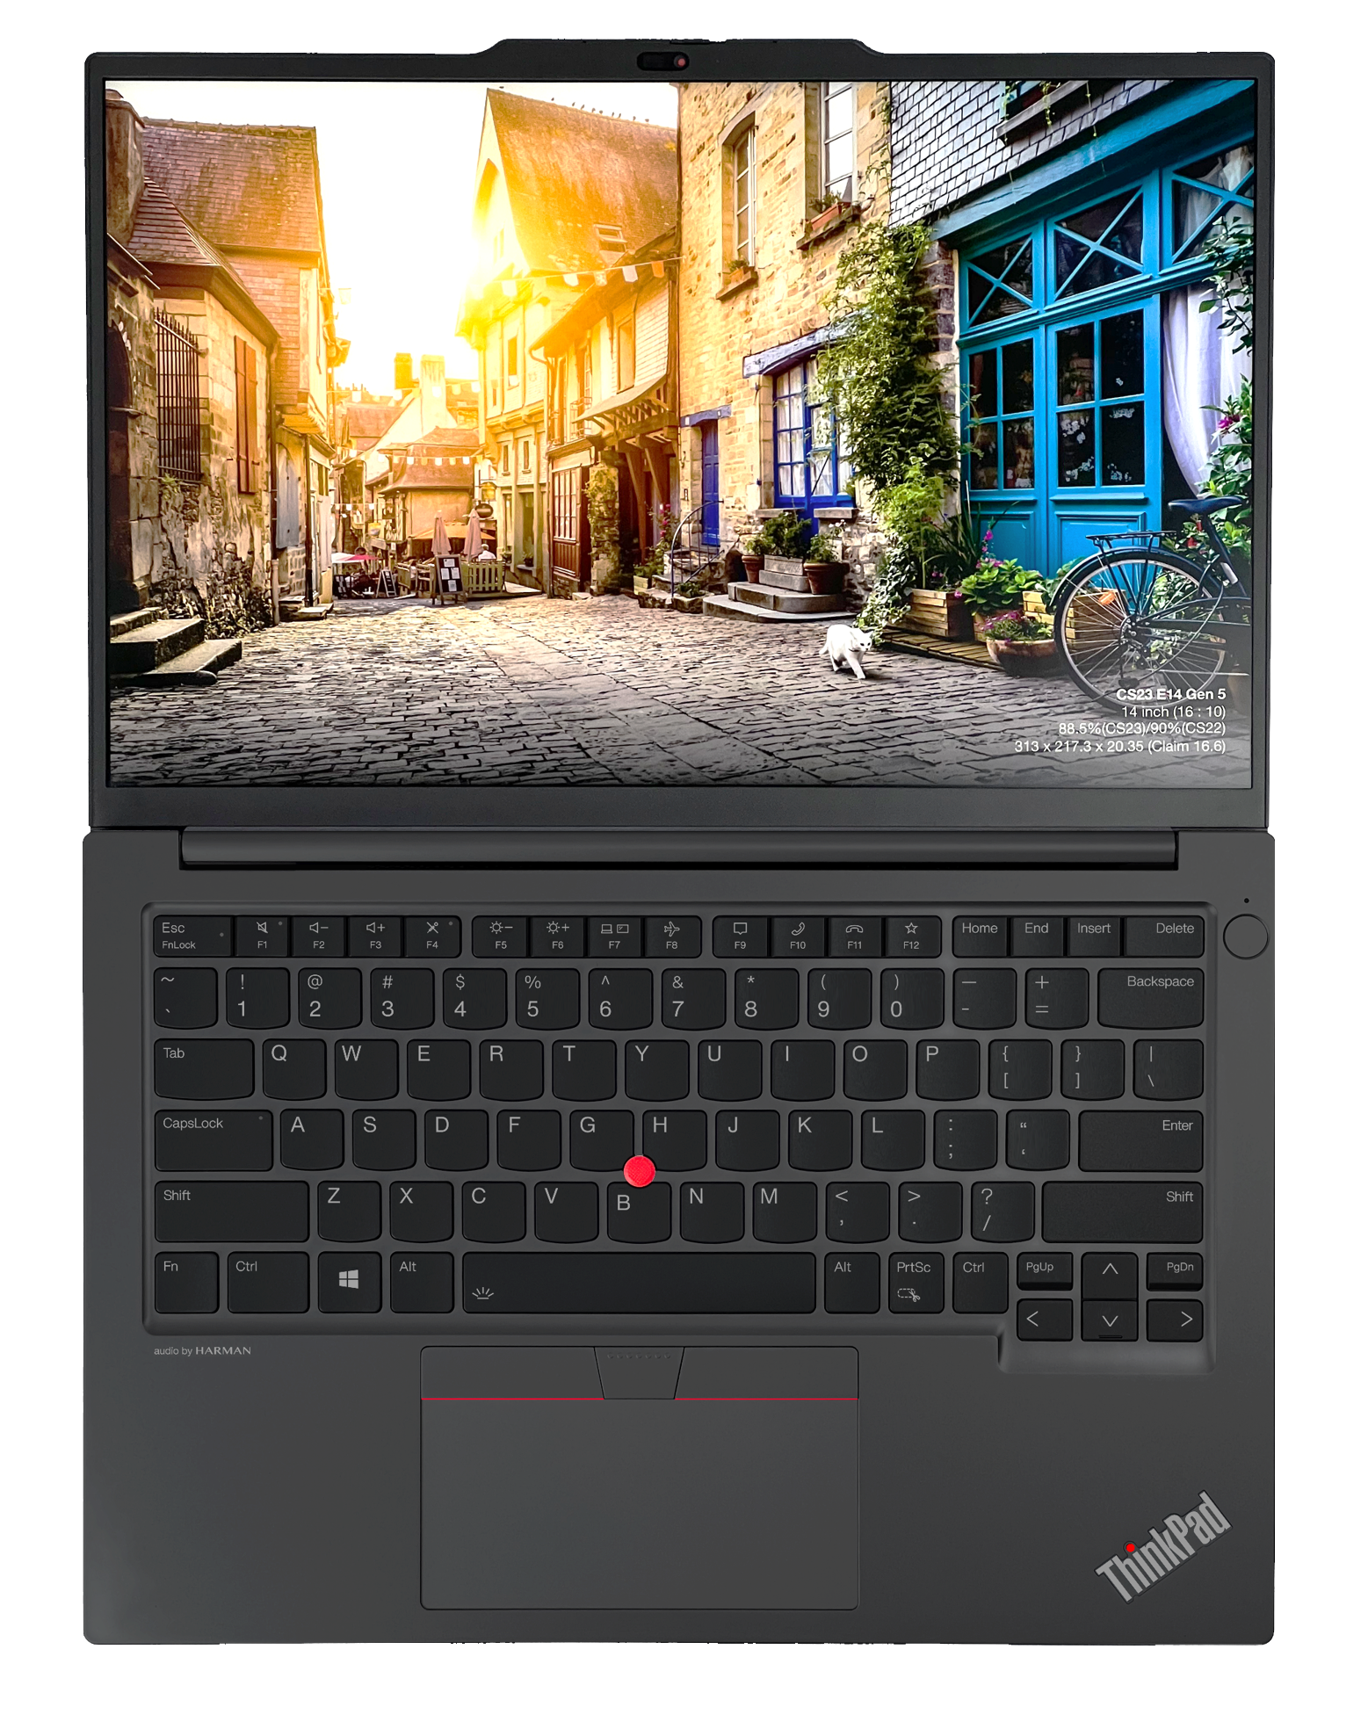
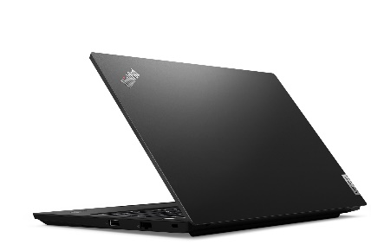
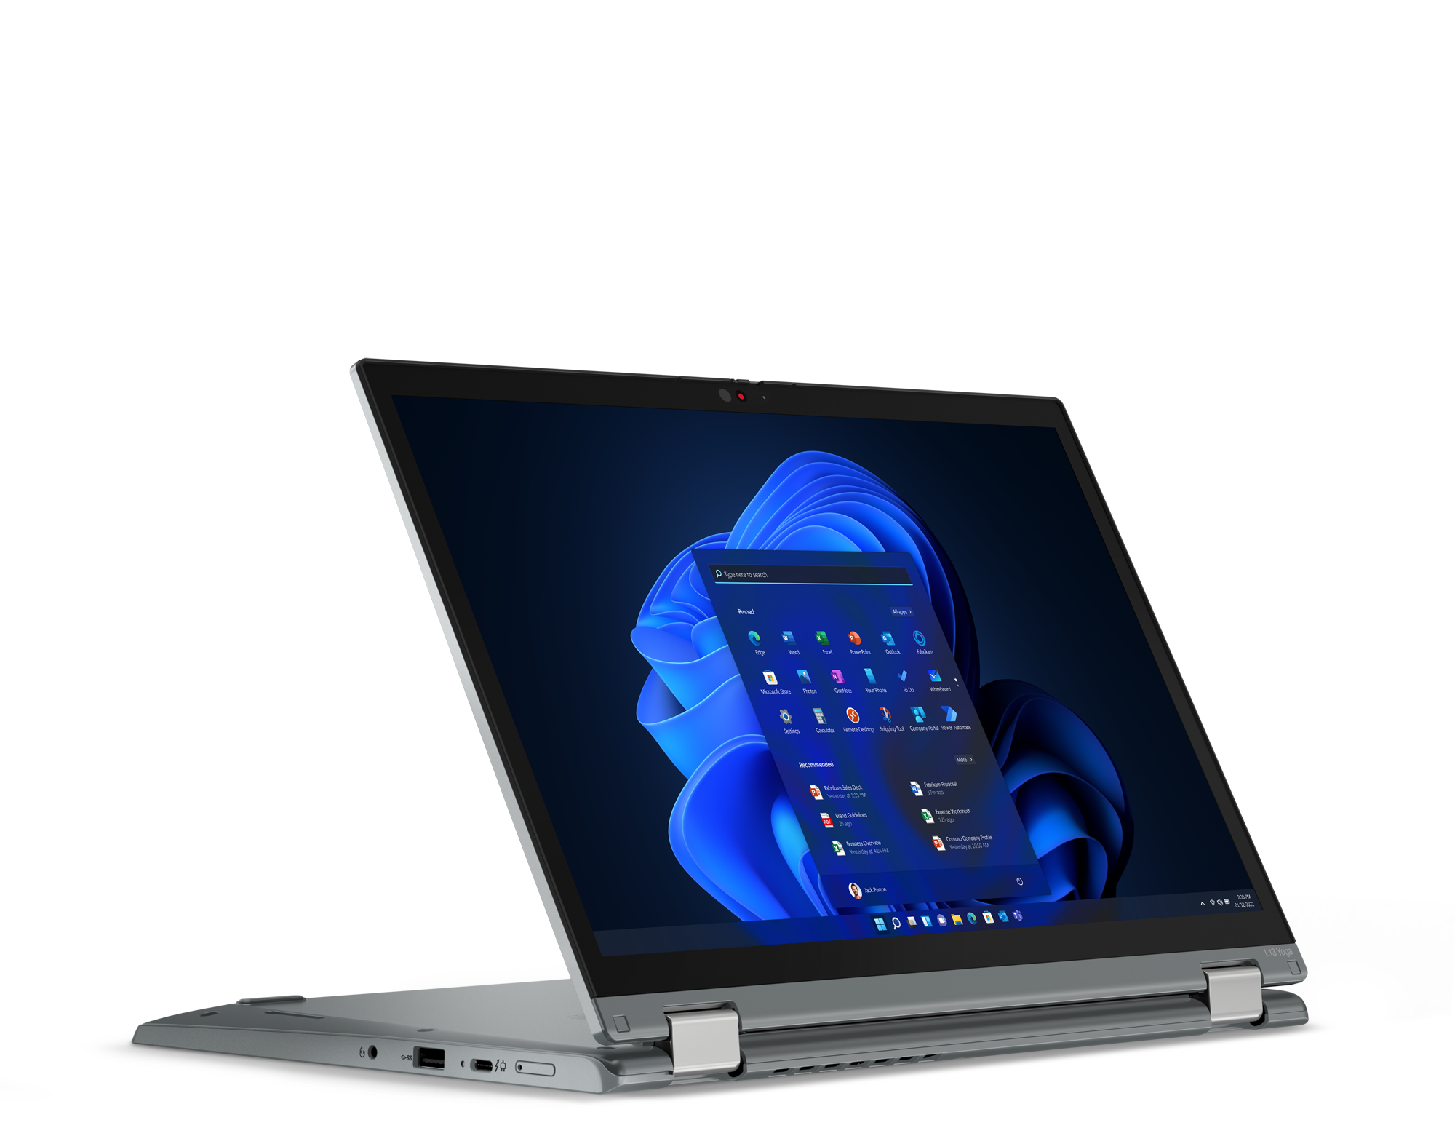
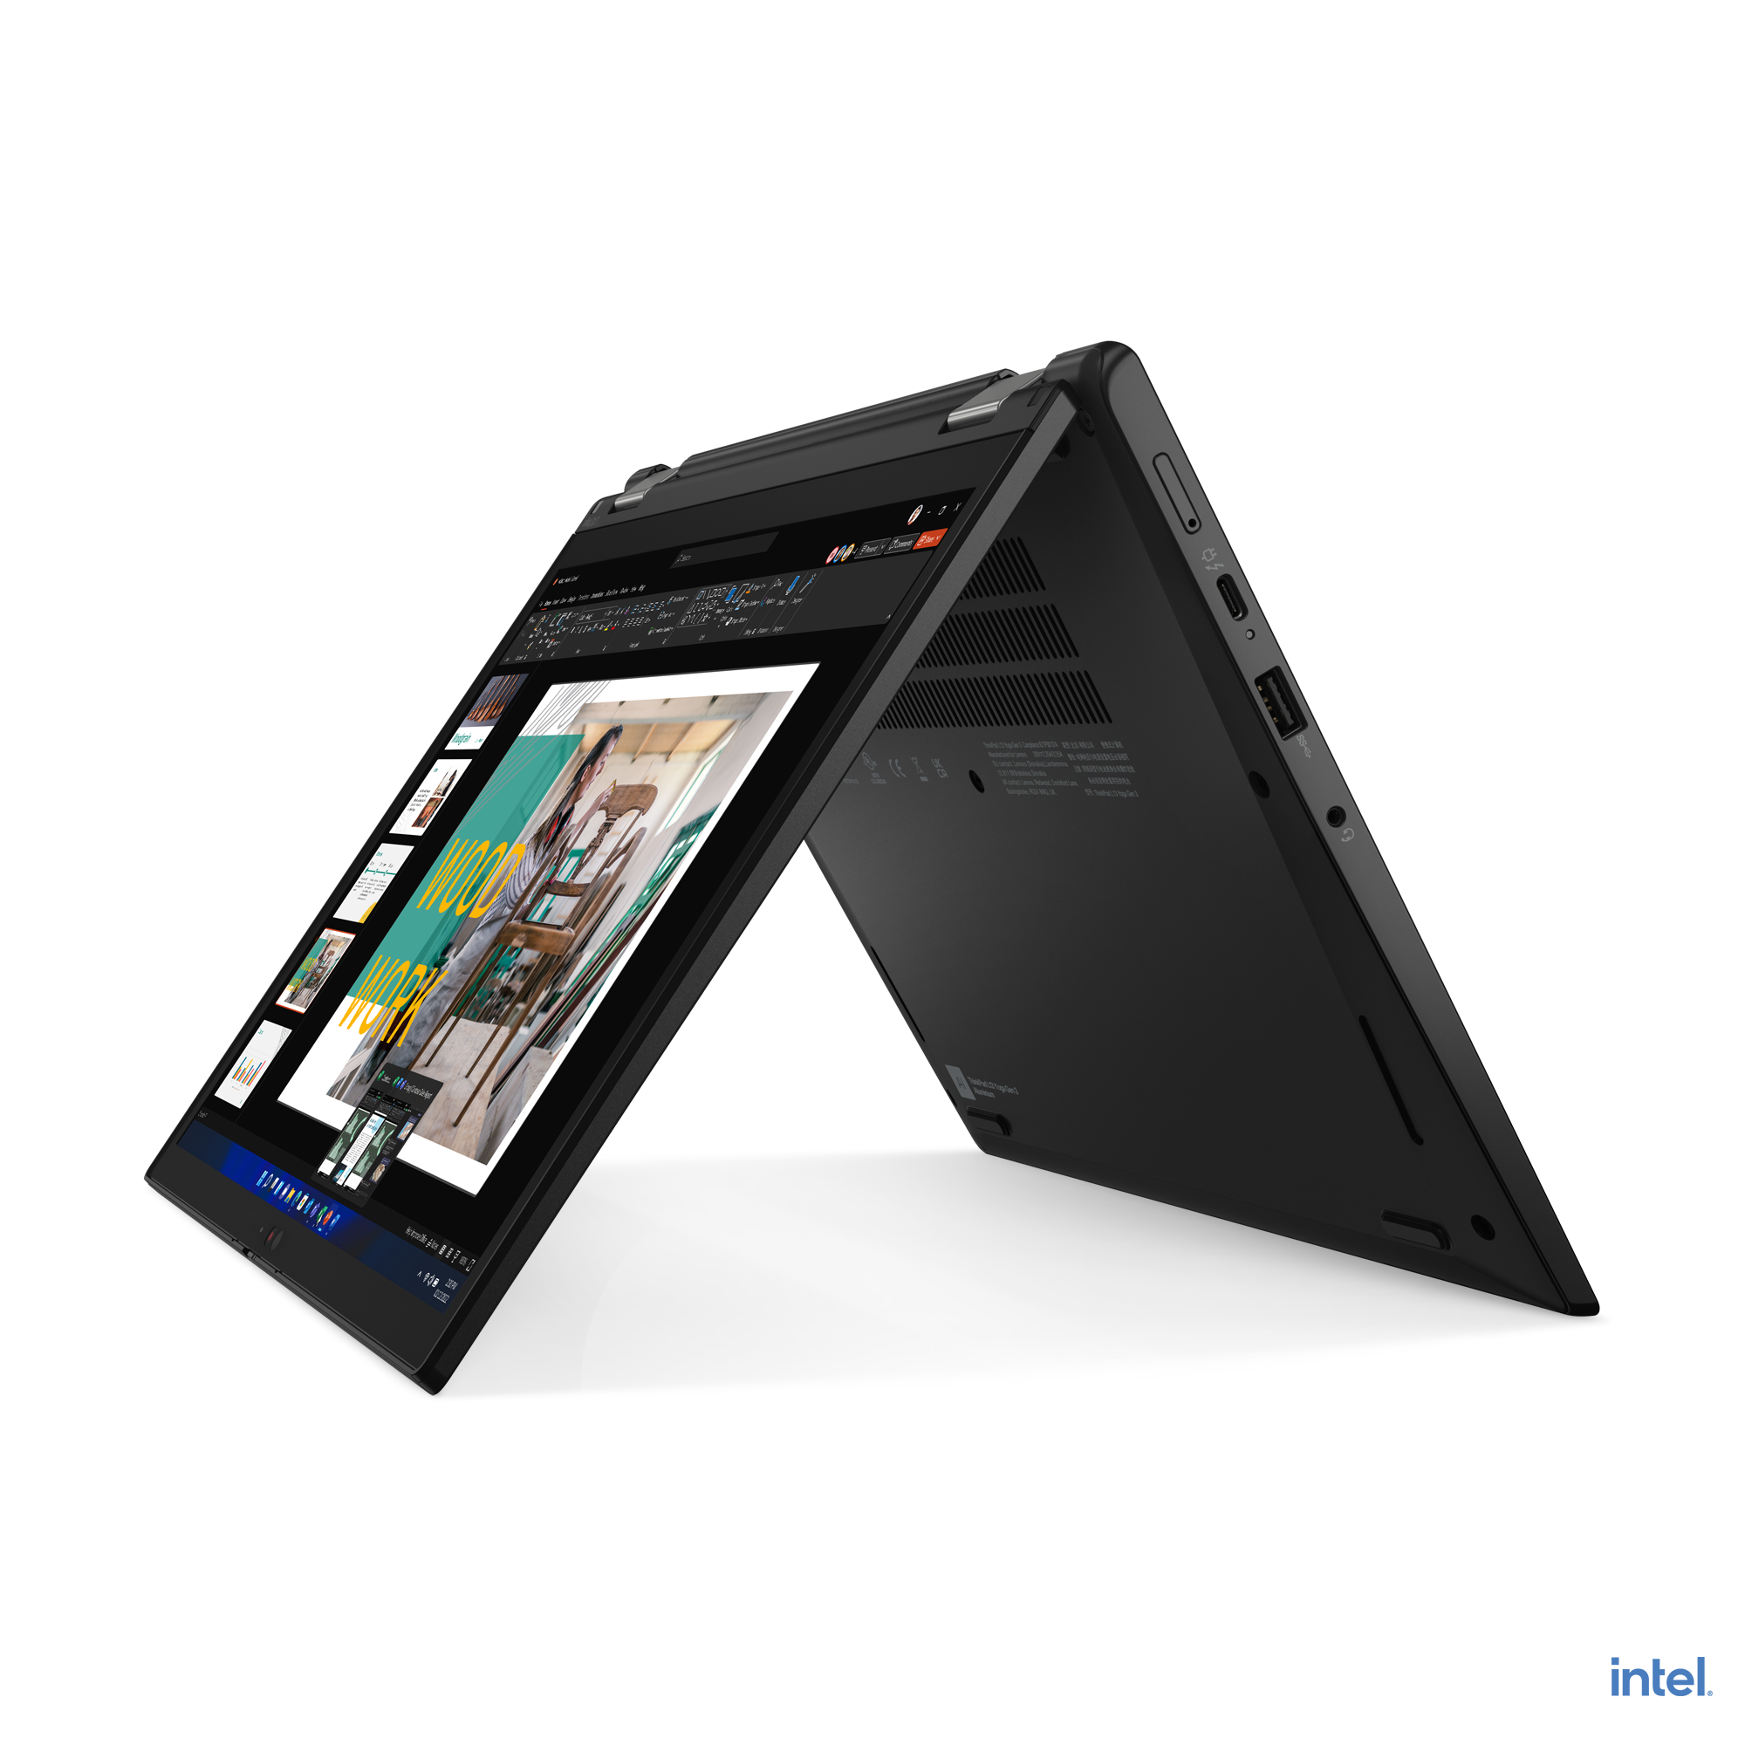
VELOCITY THINKPAD
E14 (Intel / AMD)
E16 (Intel/AMD)
L13 Yoga

Slide 11
VELOCITY THINKPAD
E14 G5 (Intel) | $909 | $979 | $1099
 | Rebate: $10 | Rebate: $10 | Rebate: $25
 | 21JK0084US | 21JK0052US | 21JK0053US
 | Core i5-1335U | Core i5-1335U | Core i7-1355U
 | 2 x 8GB DIMM | 2 x 8GB DIMM | 2 x 8GB DIMM
 | 256GB SSD NVMe | 512GB SSD NVMe | 512GB SSD NVMe
 | 14” WUXGA IPS Anti-glare | 14” WUXGA IPS Anti-glare, Touch | 14” WUXGA IPS Anti-glare, Touch
 | FHD Camera w/Shutter, 2x2 AX WLAN, BT | FHD Camera w/Shutter, 2x2 AX WLAN, BT | FHD Camera w/Shutter, 2x2 AX WLAN, BT
 | Integrated 47Whr Battery | Integrated 47Whr Battery | Integrated 47Whr Battery
 | Win11 Pro | Win11 Pro | Win11 Pro
 | 1 Year Depot | 1 Year Depot | 1 Year Depot
E14 G5 (AMD) | $649 | $829 | $949 | $979
 |  | Rebate: $10 | Rebate: $10 | Rebate: $10
 | 21JR001QUS | 21JR001RUS | 21JR001SUS | 21JR0018US
 | Ryzen 5 7530U | Ryzen 5 7530U | Ryzen 7 7730U | Ryzen 7 7730U
 | 1 x 8GB DIMM | 2 x 8GB DIMM | 2 x 8GB DIMM | 2 x 8GB DIMM
 | 256GB SSD NVMe | 256GB SSD NVMe | 512GB SSD NVMe | 512GB SSD NVMe
 | 14” WUXGA IPS Anti-glare | 14” WUXGA IPS Anti-glare | 14” WUXGA IPS Anti-glare | 14” WUXGA IPS Anti-glare, Touch
 | FHD Camera w/Shutter, 2x2 AX WLAN, BT | FHD Camera w/Shutter, 2x2 AX WLAN, BT | FHD Camera w/Shutter, 2x2 AX WLAN, BT | FHD Camera w/Shutter, 2x2 AX WLAN, BT
 | Integrated 47Whr Battery | Integrated 47Whr Battery | Integrated 47Whr Battery | Integrated 47Whr Battery
 | Win11 Pro | Win11 Pro | Win11 Pro | Win11 Pro
 | 1 Year Depot | 1 Year Depot | 1 Year Depot | 1 Year Depot
E16 G1 (Intel) | $909 | $979 | $1079 | $1099
 | Rebate: $10 | Rebate: $10 | Rebate: $15 | Rebate: $25
 | 21JN003YUS | 21JN0040US | 21JN0073US | 21JN003XUS
 | Core i5-1335U | Core i5-1335U | Core i7-1355U | Core i7-1355U
 | 2 x 8GB DIMM | 2 x 8GB DIMM | 2 x 8GB DIMM | 2 x 8GB DIMM
 | 256GB SSD NVMe | 512GB SSD NVMe | 512GB SSD NVMe | 512GB SSD NVMe
 | 16” WUXGA IPS Anti-glare | 16” WUXGA IPS Anti-glare, Touch | 16” WUXGA IPS Anti-glare | 16” WUXGA IPS Anti-glare, Touch
 | FHD Camera w/Shutter, 2x2 AX WLAN, BT | FHD Camera w/Shutter, 2x2 AX WLAN, BT | FHD Camera w/Shutter, 2x2 AX WLAN, BT | FHD Camera w/Shutter, 2x2 AX WLAN, BT
 | Integrated 47Whr Battery | Integrated 47Whr Battery | Integrated 47Whr Battery | Integrated 47Whr Battery
 | Win11 Pro | Win11 Pro | Win11 Pro | Win11 Pro
 | 1 Year Depot | 1 Year Depot | 1 Year Depot | 1 Year Depot
E16 G1 (AMD) | $649 | $829 | $949 | $979
 |  | Rebate: $10 | Rebate: $10 | Rebate: $10
 | 21JT001PUS | 21JT001BUS | 21JT001QUS | 21JT001AUS
 | Ryzen 5 7530U | Ryzen 5 7530U | Ryzen 7 7730U | Ryzen 7 7730U
 | 1 x 8GB DIMM | 2 x 8GB DIMM | 2 x 8GB DIMM | 2 x 8GB DIMM
 | 256GB SSD NVMe | 256GB SSD NVMe | 512GB SSD NVMe | 512GB SSD NVMe
 | 16” WUXGA IPS Anti-glare | 16” WUXGA IPS Anti-glare | 16” WUXGA IPS Anti-glare | 16” WUXGA IPS Anti-glare, Touch
 | FHD Camera w/Shutter, 2x2 AX WLAN, BT | FHD Camera w/Shutter, 2x2 AX WLAN, BT | FHD Camera w/Shutter, 2x2 AX WLAN, BT | FHD Camera w/Shutter, 2x2 AX WLAN, BT
 | Integrated 47Whr Battery | Integrated 47Whr Battery | Integrated 47Whr Battery | Integrated 47Whr Battery
 | Win11 Pro | Win11 Pro | Win11 Pro | Win11 Pro
 | 1 Year Depot | 1 Year Depot | 1 Year Depot | 1 Year Depot

Slide 12
VELOCITY THINKPAD
L13 G4 Yoga (Intel) | $1449 | $1589
 | 21FJ002CUS | 21FJ002DUS
 | Core i5-1335U | Core i7-1355U
 | 16GB DIMM | 16GB DIMM
 | 512GB SSD NVMe | 512GB SSD NVMe
 | 13.3” WUXGA IPS Anti-glare Touch | 13.3” WUXGA IPS Anti-glare Touch
 | HD Camera w/Shutter, FPR, 2x2 AX WLAN, BT, Backlit Keyboard, Black | IR Camera w/Shutter, FPR, 2x2 AX WLAN, BT, Backlit Keyboard, Black
 | Integrated 46Whr Battery | Integrated 46Whr Battery
 | Win11 Pro | Win11 Pro
 | 3 Year Depot | 3 Year Depot

Slide 13
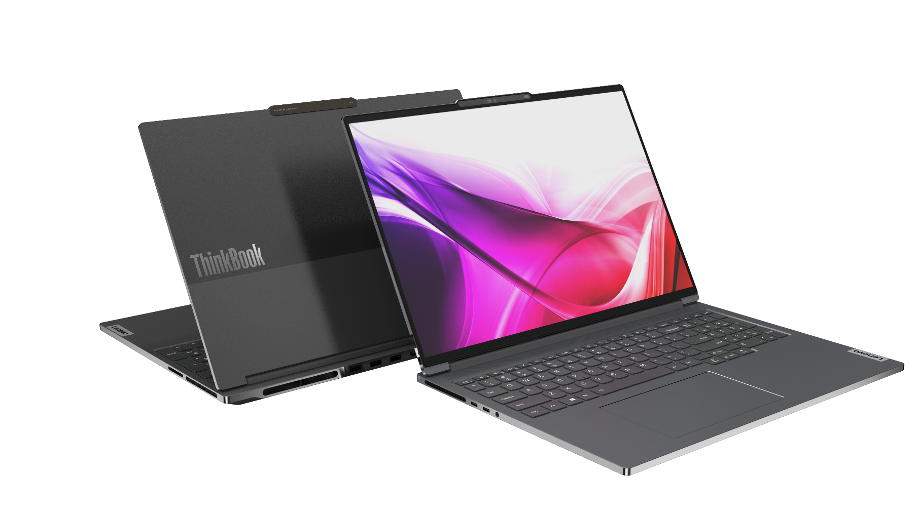
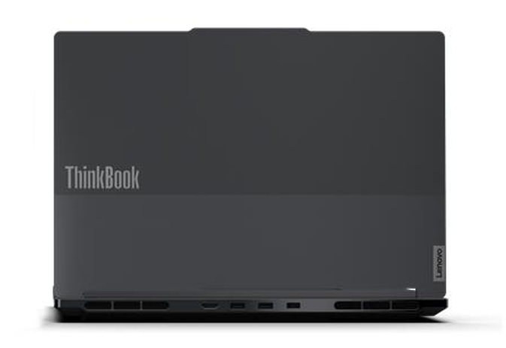
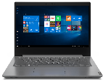
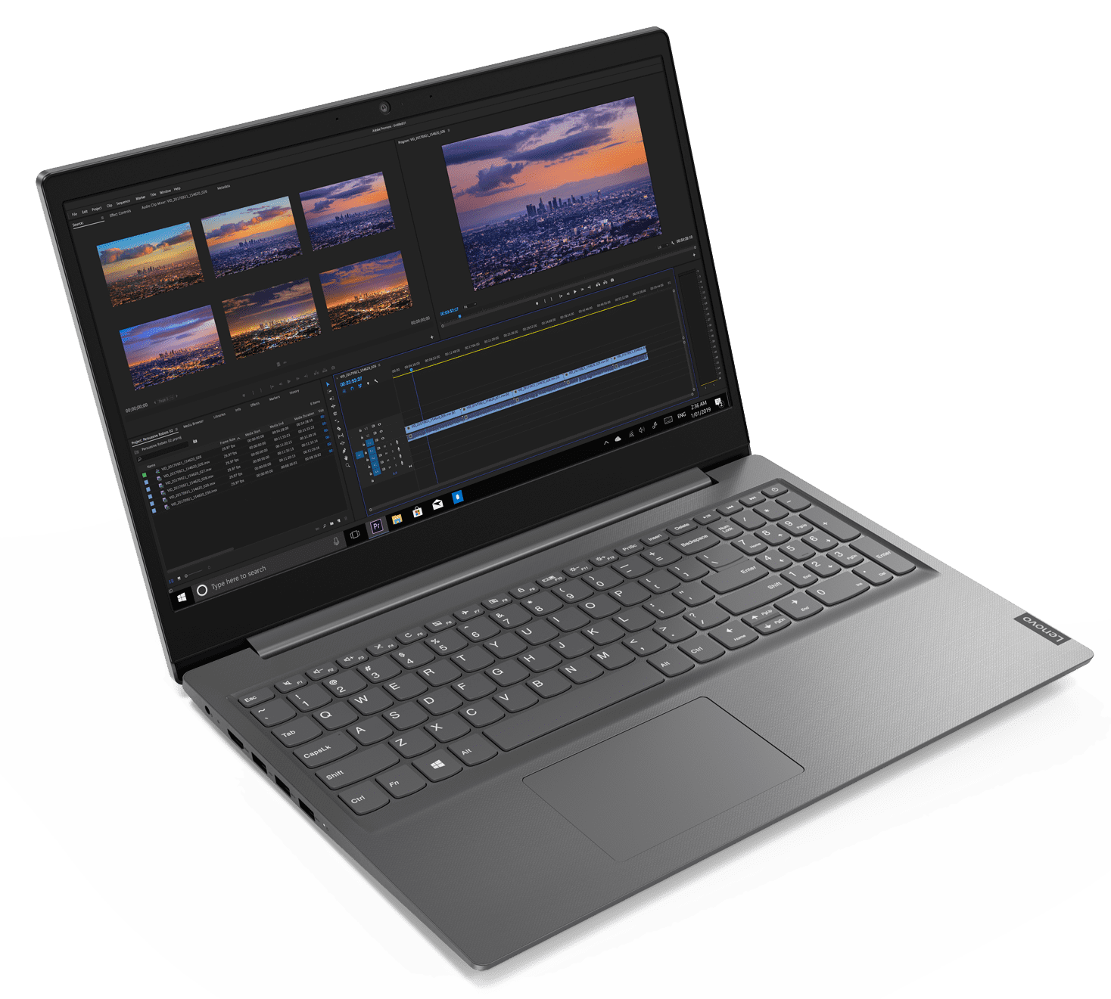
LENOVO TOPSELLER NOTEBOOKS
ThinkBook 14 (Intel / AMD)
ThinkBook 16 (Intel / AMD)
Lenovo V14
Lenovo V15

Slide 14
VELOCITY NOTEBOOKS
ThinkBook 14 G6 (Intel) | $899 | $969 | $1099
 | 21KG0005US | 21KG000AUS | 21KG000FUS
 | Core i5-1335U | Core i5-1335U | i7-1355U
 | 2 x 8GB DIMM | 2 x 8GB DIMM | 2 x 8GB DIMM
 | 256GB SSD NVMe | 512GB SSD NVMe | 512GB SSD NVMe
 | 14” WUXGA IPS Anti-glare | 14” WUXGA IPS Anti-glare Touch | 14” WUXGA IPS Anti-glare Touch
 | FHD Camera w/Shutter, 2x2 AX WLAN, BT, Backlit Keyboard, Aluminum | FHD Camera w/Shutter, 2x2 AX WLAN, BT, Backlit Keyboard, Aluminum | FHD Camera w/Shutter, 2x2 AX WLAN, BT, Backlit Keyboard, Aluminum
 | Integrated 45Whr Battery | Integrated 45Whr Battery | Integrated 45Whr Battery
 | Win11 Pro | Win11 Pro | Win11 Pro
 | 1 Year Depot | 1 Year Depot | 1 Year Depot
ThinkBook 14 G6 (AMD) | $679 | $869 | $959
 | 21KJ0004US | 21KJ0009US | 21KJ000EUS
 | Ryzen 5 7530U | Ryzen 5 7530U | Ryzen 7 7730U
 | 1 x 8GB DIMM | 2 x 8GB DIMM | 2 x 8GB DIMM
 | 256GB SSD NVMe | 512GB SSD NVMe | 512GB SSD NVMe
 | 14” WUXGA IPS Anti-glare | 14” WUXGA IPS Anti-glare Touch | 14” WUXGA IPS Anti-glare Touch
 | FHD Camera w/Shutter, 2x2 AX WLAN, BT, Backlit Keyboard, Aluminum | FHD Camera w/Shutter, 2x2 AX WLAN, BT, Backlit Keyboard, Aluminum | FHD Camera w/Shutter, 2x2 AX WLAN, BT, Backlit Keyboard, Aluminum
 | Integrated 45Whr Battery | Integrated 45Whr Battery | Integrated 45Whr Battery
 | Win11 Pro | Win11 Pro | Win11 Pro
 | 1 Year Depot | 1 Year Depot | 1 Year Depot
ThinkBook 14s Yoga G3 | $1099 | $1149 | $1269
 |  | Rebate: $25
 | 21JG0019US | 21JG0018US | 21JG001FUS
 | Core i5-1335U | Core i5-1335U | Core i7-1355U
 | 8GB DIMM + 8GB DIMM | 8GB DIMM + 8GB DIMM | 8GB DIMM + 8GB DIMM
 | 256GB SSD NVMe | 512GB SSD NVMe | 512GB SSD NVMe
 | 14” FHD IPS Touch sRGB | 14” FHD IPS Touch sRGB | 14” FHD IPS Touch sRGB
 | Camera w/Shutter, FPR, 2x2 AX WLAN, BT, Aluminum, Backlit Keyboard | Camera w/Shutter, FPR, 2x2 AX WLAN, BT, Aluminum, Backlit Keyboard | Camera w/Shutter, FPR, 2x2 AX WLAN, BT, Aluminum, Backlit Keyboard
 | Integrated 60Whr Battery | Integrated 60Whr Battery | Integrated 60Whr Battery
 | Win11 Pro | Win11 Pro | Win11 Pro
 | 1 Year Depot | 1 Year Depot | 1 Year Depot

Slide 15
VELOCITY NOTEBOOKS
ThinkBook 16 G6 Intel | $889 | $989 | $1119
 | 21KH0005US | 21KH000AUS | 21KH000FUS
 | Core i5-1335U | Core i5-1335U | i7-1355U
 | 2 x 8GB DIMM | 2 x 8GB DIMM | 2 x 8GB DIMM
 | 256GB SSD NVMe | 512GB SSD NVMe | 512GB SSD NVMe
 | 16” WUXGA IPS Anti-glare | 16” WUXGA IPS Anti-glare Touch | 16” WUXGA IPS Anti-glare Touch
 | FHD Camera w/Shutter, 2x2 AX WLAN, BT, Backlit Keyboard, Aluminum | FHD Camera w/Shutter, 2x2 AX WLAN, BT, Backlit Keyboard, Aluminum | FHD Camera w/Shutter, 2x2 AX WLAN, BT, Backlit Keyboard, Aluminum
 | Integrated 45Whr Battery | Integrated 45Whr Battery | Integrated 45Whr Battery
 | Win11 Pro | Win11 Pro | Win11 Pro
 | 1 Year Depot | 1 Year Depot | 1 Year Depot
ThinkBook 16 G6 AMD | $679 | $889 | $979
 | 21KK0004US | 21KK0009US | 21KK000EUS
 | Ryzen 5 7530U | Ryzen 5 7530U | Ryzen 7 7730U
 | 1 x 8GB DIMM | 2 x 8GB DIMM | 2 x 8GB DIMM
 | 256GB SSD NVMe | 512GB SSD NVMe | 512GB SSD NVMe
 | 16” WUXGA IPS Anti-glare | 16” WUXGA IPS Anti-glare Touch | 16” WUXGA IPS Anti-glare Touch
 | FHD Camera w/Shutter, 2x2 AX WLAN, BT, Backlit Keyboard, Aluminum | FHD Camera w/Shutter, 2x2 AX WLAN, BT, Backlit Keyboard, Aluminum | FHD Camera w/Shutter, 2x2 AX WLAN, BT, Backlit Keyboard, Aluminum
 | Integrated 45Whr Battery | Integrated 45Whr Battery | Integrated 45Whr Battery
 | Win11 Pro | Win11 Pro | Win11 Pro
 | 1 Year Depot | 1 Year Depot | 1 Year Depot
ThinkBook G4 16p | $1649 | $1929
 | 21J8002LUS | 21J8002RUS
 | Core i5-13500H | Core i7-13700H
 | 16GB DIMM | 16GB DIMM
 | 512GB SSD NVMe | 512GB SSD NVMe
 | 16" WQXGA (2560x1600) IPS 400nits Anti-glare, 100% sRGB, 60Hz, Dolby® Vision | 16" WQXGA (2560x1600) IPS 400nits Anti-glare, 100% sRGB, 60Hz, Dolby® Vision
 | FHD 1080p + IR Hybrid with Privacy Shutter, FPR, Backlit Keyboard | FHD 1080p + IR Hybrid with Privacy Shutter, FPR, Backlit Keyboard
 | Integrated 80Wh | Integrated 80Wh
 | Win11 Pro | Win11 Pro
 | 1 Year Depot | 1 Year Depot

Slide 16
VELOCITY NOTEBOOKS
Lenovo V14 G4 – AMD | $529
 | 82YX000BUS
 | AMD R5 5500U
 | 1 x 8 GB (soldered)
 | 256 SSD M.2 NVMe
 | 14” FHD TN Anti-glare
 | HD Camera w/Shutter, 2x2 AX WLAN, BT
 | Integrated 38Whr Battery
 | Win 11 Pro
 | 1 Year Depot
Lenovo V14 G4 - Intel | $599 | $699
 | 83A0004GUS | 83A00023US
 | Intel Core i3-1315U | Intel Core i5-1335U
 | 8 GB (2 x 4GB DDR) | 1 x 8GB DIMM
 | 256 SSD M.2 NVMe | 256 SSD M.2 NVMe
 | 14” FHD TN Anti-glare | 14” FHD TN Anti-glare
 | HD Camera w/Shutter, 2x2 AX WLAN, BT | HD Camera w/Shutter, 2x2 AX WLAN, BT
 | Integrated 38Whr Battery | Integrated 38Whr Battery
 | Win 11 Pro | Win 11 Pro
 | 1 Year Depot | 1 Year Depot
Lenovo V15 G4 - AMD | $529
 | 83CR0005US
 | AMD R5 5500U
 | 1 x 8 GB (soldered)
 | 256 SSD M.2 NVMe
 | 15.6” FHD TN Anti-glare
 | HD Camera w/Shutter, 2x2 AX WLAN, BT
 | Integrated 38Whr Battery
 | Win 11 Pro
 | 1 Year Depot
Lenovo V15 G4 - Intel | $599 | $699
 | 83A10028US | 83A10024US
 | Intel Core i3-1315U | Intel Core i5-1335U
 | 8 GB (2 x 4GB DDR) | 1 x 8GB DIMM
 | 256 SSD M.2 NVMe | 256 SSD M.2 NVMe
 | 15.6” FHD TN Anti-glare | 15.6” FHD TN Anti-glare
 | HD Camera w/Shutter, 2x2 AX WLAN, BT | HD Camera w/Shutter, 2x2 AX WLAN, BT
 | Integrated 38Whr Battery | Integrated 38Whr Battery
 | Win 11 Pro | Win 11 Pro
 | 1 Year Depot | 1 Year Depot

Slide 17
Tablets

Slide 18
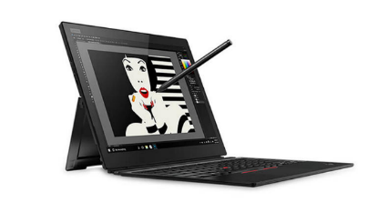
Tablets
X1 Tablet | $1,699 | $1,849
 | 20KJ0019US | 20KJ0017US
 | Core i5-8350u | Core i7-8650u
 | 8GB | 8GB
 | 256GB PCIe SSD | 256GB PCIe SSD
 | 13” QHD+ Touch | 13” QHD+ Touch
 | Camera, BT, FPR, Backlit. pen | Camera, BT, FPR, Backlit. pen
 | 3 Cell Battery | 3 Cell Battery
 | Win 10 Pro | Win 10 Pro
 | 3 Year Depot | 3 Year Depot
Tablet 10 | $529
 | 20L3000HUS
 | Celeron N4100
 | 4GB
 | 128GB eMMC
 | 10.1” WUXGA Touch
 | Camera, BT, FPR, Garaged Pen
 | 10.6mm / 1.46lbs
 | Win 10 Pro
 | 1 Year Depot

Slide 19

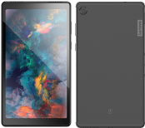
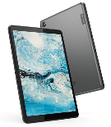
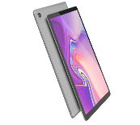
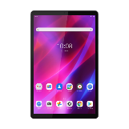
LENOLENOVO TOPSELLER - Android Focus Models R
Android Focus Models
Tab M8 HD | Tab M8 HD LTE (For Business) | Tab M10 FHD Plus | K10
$129.99 | $209 | $179.99 | $229.99
ZA5G0132US | ZA790003US | ZA5T0423US | ZA8N0064US​
8”HD Display | 8”HD Display | 10.3” FHD Display | 10.3” FHD Display
Android 10 | Android 10 | Android 10 | Android 11
Quad Core Processor | Quad Core Processor | Octa Core Processor | Octa Core Processor
2/5 MP Camera | 2/5 MP Camera | 2/5 MP Camera | 5/8 MP Camera
2/16 GB RAM and Storage | 2/32 GB RAM and Storage | 2/32 GB RAM and Storage | 3/32 GB RAM and Storage
2*Dolby Audio Speakers | 2*Dolby Audio Speakers | 2*Dolby Audio Speakers | 2*Dolby Audio Speakers
2.4/5G. BT 5.0 | 2.4/5G. BT 5.0 Plus LTE | 2.4/5G. BT 5.0 | 2.4/5G. BT 5.0
5,000MAh Battery | 5,000MAh Battery | 5,000MAh Battery | 7,700MAh Battery
Micro USB Port | USB-C 2.0 Port | USB-C 2.0 Port | USB-C 2.0 Port
1 Year Depot Warranty | 1 Year Depot Warranty | 1 Year Depot Warranty | 1 Year Depot Warranty

Slide 20
LENOVO TOPSELLER
Android Top seller Models
New!
New!
New!
Model ​ | M8 HD​ | ST M8 HD​ | M8 HD​ | ST M8 HD​ | M10 FHD Plus​ | M10 FHD Plus​ | ST M10 FHD Plus w/ Alexa​ | P12 Pro Bundle ​ | K10 ​ | K10​ | K10​ | K10​ Batteryless | K10 LTE Batteryless​
MTM​ | ZA5G0132US​ | ZA5C0050US​ | ZA790003US​ | ZA790002US​ | ZA5T0423US​ | ZA5T0382US​ | ZA6M0055US​ | ZAAX0000US | ZA8N0064US​ | ZA8N0044US​ | ZA8S0000US​ | ZA8T0001US​ | ZA9K0000US​
MSRP​ | $129​ | $139​ | $209​ | $219​ | 179​ | $199​ | $189​ | $729 | $229​ | $249​ | $269​ | $219​ | $269​
Focus Model​ | YES​ | ​ | YES​ | ​ | YES​ | ​ | ​ | ​ | YES​ | ​ | ​ | ​ | ​
LTE​ | ​ | ​ | YES​ | YES​ | ​ | ​ | ​ | ​ | ​ | ​ | YES​ | ​ | YES​
Display​ | 8” HD​ | 8” HD​ | 8” HD​ | 8” HD​ | 10.3” FHD​ | 10.3” FHD​ | 10.3” FHD​ | 12.6” AMOLED | 10.3” FHD​ | 10.3” FHD​ | 10.3” FHD​ | 10.3” FHD​ | 10.3” FHD​
OS​ | 10​ | 10​ | 10​ | 10​ | 10​ | 10​ | 10​ | 10​ | 11​ | 11​ | 11​ | 11​ | 11​
Processor​ | Quad Core​ | Quad Core​ | Quad Core​ | Quad Core​ | Octa Core​ | Octa Core​ | Octa Core​ | Octa Core​ | Octa Core​ | Octa Core​ | Octa Core​ | Octa Core​ | Octa Core​
Camera​ | 2/5MP​ | 2/5MP​ | 2/5MP​ | 2/5MP​ | 5/8MP​ | 5/8MP​ | 5/8MP​ | 8/13MP​ | 5/8MP w/ Flash​ | 5/8MP w/ Flash​ | 5/8MP w/ Flash​ | 5/8MP w/ Flash​ | 5/8MP w/ Flash​
Ram/Storage​ | 2/16GB​ | 2/16GB​ | 2/32GB​ | 2/32GB​ | 2/32GB​ | 4/64GB​ | 2/32GB​ | 8/256GB​ | 3/32GB​ | 4/64GB​ | 3/32GB​ | 3/32GB​ | 4/64GB​
Audio​ | 2 x Dolby​ | 2 x Dolby​ | 2 x Dolby​ | 2 x Dolby​ | 2 x Dolby​ | 2 x Dolby​ | 2 x Dolby​ | 4 x JBL​ | 2 x Dolby​ | 2 x Dolby​ | 2 x Dolby​ | 2 x Dolby​ | 2 x Dolby​
Wireless​ | 2.4/5G, BT 5.0​ | 2.4/5G, BT 5.0​ | 2.4/5G, BT 5.0​ | 2.4/5G, BT 5.0​ | 2.4/5G, BT 5.0​ | 2.4/5G, BT 5.0​ | 2.4/5G, BT 5.0​ | 2.4/5G, WIFI6, BT 5.2​ | 2.4/5G, BT 5.0​ | 2.4/5G, BT 5.0​ | 2.4/5G, BT 5.0​ | 2.4/5G, BT 5.0​ | 2.4/5G, BT 5.0​
Battery​ | 5,000mAh​ | 5,000mAh​ | 5,000mAh​ | 5,000mAh​ | 5,000mAh​ | 5,000mAh​ | 5,000mAh​ | 10,200 mAh​ | 7,700 mAh​ | 7,700 mAh​ | 7,700 mAh​ | No Battery​ | No Battery​
Ports ​ | Micro USB​ | Micro USB​ | USB-C 2.0​ | USB-C 2.0​ | USB-C 2.0​ | USB-C 2.0​ | USB-C 2.0​ | USB-C 3.1​ | USB-C 2.0​ | USB-C 2.0​ | USB-C 2.0​ | USB-C 2.0​ | USB-C 2.0​
Features​ | ​ | Cradle​ | ​ | Cradle​ | ​ | ​ | Dock​ | Keyboard + Pen​ | 3Yr Life Cycle​ | 3Yr Life Cycle​ | 3Yr Life Cycle​ | 3Yr Life Cycle​ | 3Yr Life Cycle​
Mil Spec​ | NA​ | NA​ | NA​ | NA​ | NA​ | NA​ | NA​ | NA​ | NA​ | NA​ | NA​ | NA​ | NA​
Warranty​ | 1 Year Depot​ | 1 Year Depot​ | 1 Year Depot​ | 1 Year Depot​ | 1 Year Depot​ | 1 Year Depot​ | 1 Year Depot​ | 1 Year Depot​ | 1 Year Depot​ | 1 Year Depot​ | 1 Year Depot​ | 1 Year Depot​ | 1 Year Depot​

Slide 21
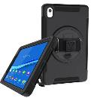
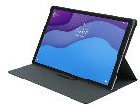

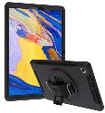
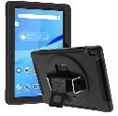
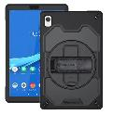
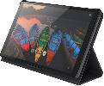
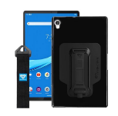

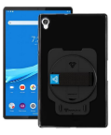
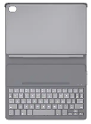
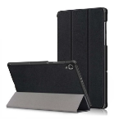
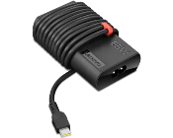

LENOVO Android Tablets Accessories
M8
M10
Tab M8 HD Folio Case
ZG38C02862
$14.99
Armor-X M8 HD/FHD
78016354
$39.99
Tab M10 FHD Plus Folio Case/Film
ZG38C02958
$19.99
Tab M10 FHD Plus Keyboard Case
ZG38C03371
$49.99
* Armor X
M10 FHD Plus X606F
MTM: 78016082
RIN-LN-M10PL
$39.99
* Armor X M10 FHD
MTM:78016083
RIN-LN-M10REL
$39.99
* Armor X M10 HD 2nd Gen | 306F
78016353
$39.99
K10
* Armor-X |K10 Shockproof case w/ kickstand, hand-strap, & X-MOUNT adapter
78019394
ZXS-LN-K10
$34.99
* Kastus Ant-Microbial Screen Protector
40F0KS2001
$29.99
Tab K10 Bluetooth Keyboard Case
ZG38C03597
$99
* Rugged case for Lenovo Tablet K10
78019381
RIN-LN-K10
$34.99
* Armor-X |K10 Shockproof Case w/ kickstand, revolving hand-strap
78019393
ZUN-LN-K10
$34.99
K10 Battery Less Power Adapter
4X20V24674
$69.99
*Armor-X | K10 Folio
78019392
*Contact Synnex for a quote with Armor-X part number. NSPs that purchase direct can use Lenovo MTM to order Lenovo Direct.

Slide 22
ThinkCentre & Lenovo Desktops

Slide 23
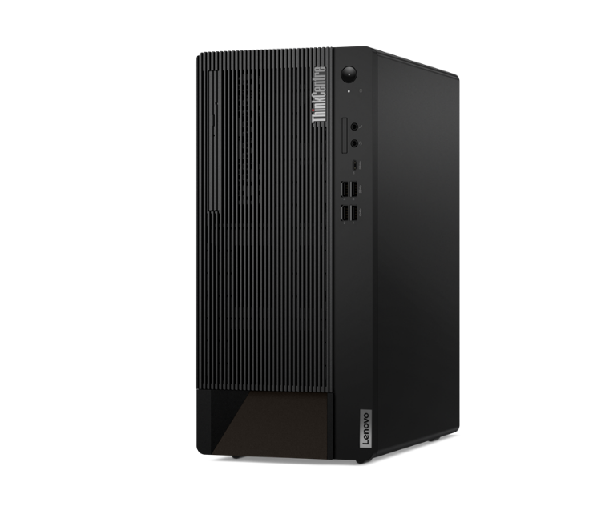
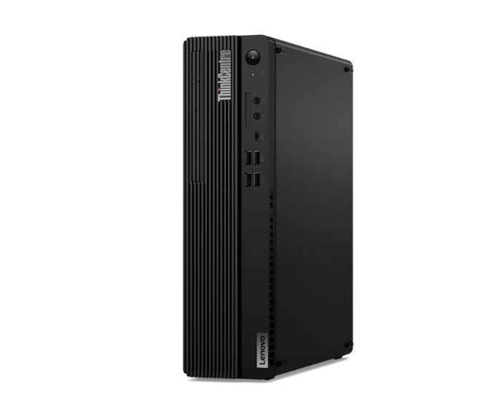
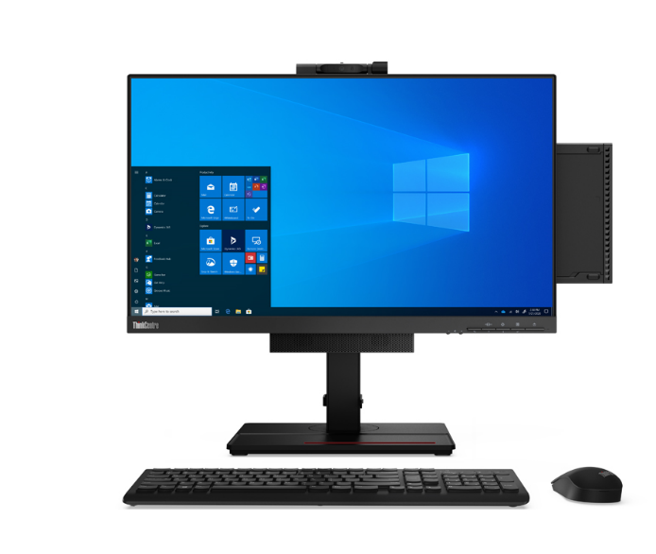
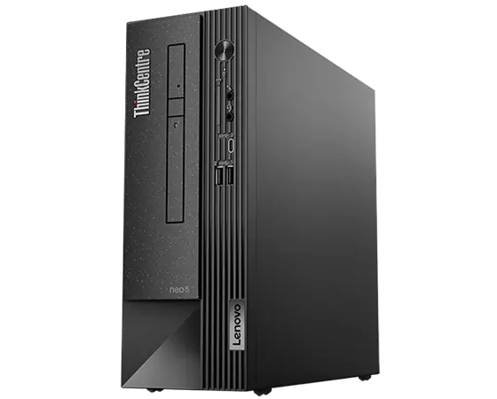
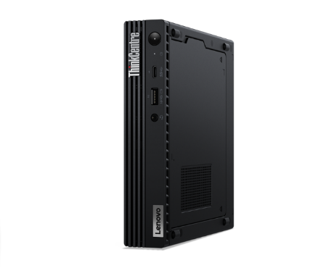
LENOVO TOPSELLER
ThinkCentre & Lenovo Desktops
LENOVO TOPSELLER
ThinkCentre & Lenovo Desktops
[ 1 OF 5 ]
ThinkCentre M75q Gen 2 Tiny (Pictured with optional Tiny-in-One)
ThinkCentre Tower
(M70t/M80t/M90t)
ThinkCentre
Small Form Factor
(M70s/M75s/M80s/M90s)
ThinkCentre Neo Small Form Factor
(Neo50s)
ThinkCentre Tiny
(Neo 50q/M70q/M75q/M80q/M90q)

Slide 24

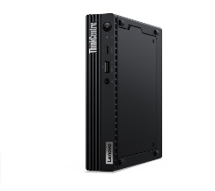
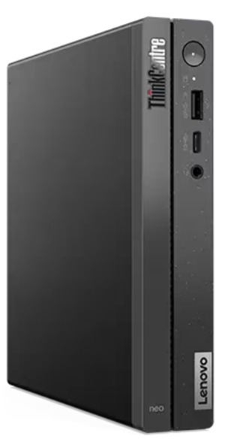
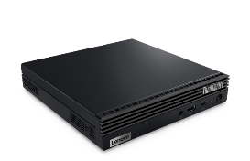
ThinkCentre Tiny Desktops
M75q Tiny Gen 2 | $669 | $769 | $829
 | $20 Rebate | $30 Rebate | $60 Rebate
 | 11JN008BUS | 11JN002PUS | 11JN0089US
 | Ryzen 3 PRO 5350GE | Ryzen 5 PRO 5650GE | Ryzen 5 PRO 5650GE
 | 8GB Memory | 8GB Memory | 16GB Memory
 | 256GB SSD M.2 PCIe | 256GB SSD M.2 PCIe | 256GB SSD M.2 PCIe
 | Win11 Pro 64 | Win11 Pro 64 | Win11 Pro 64
 | 3 Year Onsite | 3 Year Onsite | 3 Year Onsite
$989
$40 Rebate
11JN002RUS
Ryzen 7 PRO 5750GE
16GB Memory
512GB SS M.2 PCIe
Win11 Pro 64
3 Year Onsite
ThinkCentre M75q Gen 2 Tiny (Pictured with Tiny-in-One)
Neo 50q Gen 4 | $699 | $749
 | $50 Rebate | $50 Rebate
 | 12LN000CUS | 12LN000BUS
 | Core i5-13420H | Core i5-13420H
 | 8GB DDR4 2666MHz | 16GB DDR4 2666MHz
 | 256GB M.2 SSD | 256GB M.2 SSD
 | 2x2 AC Wi-Fi + BT 5.2 | 2x2 AC Wi-Fi + BT 5.2
 | DP + HDMI | DP + HDMI
 | Win11 Pro 64 | Win11 Pro 64
 | 1 Year Onsite | 1 Year Onsite
Neo 50q Gen 4

Slide 25
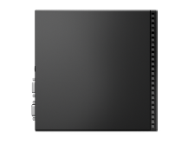
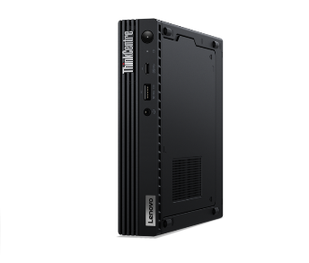

ThinkCentre Gen 3 Alderlake Tiny Desktops
M70q Tiny Gen 3 | $869 | $919 | $949 | $1,199
 | $100 Rebate | $50 Rebate | $50 Rebate | $50 Rebate
 | 11T3000BUS | 11T300C0US | 11T300C9US | 11T3000RUS
 | Core i5-12400T | Core i5-12400T | Core i5-12400T | Core i7-12700T
 | 8GB DDR4 2666MHz | 16GB DDR4 2666MHz | 16GB DDR4 2666MHz | 16GB DDR4 2666MHz
 | 256GB SSD M.2 PCIe | 256GB SSD M.2 PCIe | 512GB SSD M.2 PCIe | 256GB SSD M.2 PCIe
 | Win11 Pro 64 | Win11 Pro 64 | Win11 Pro 64 | Win11 Pro 64 Win10 DG
 | 3 Year Onsite | 3 Year Onsite | 3 Year Onsite | 3 Year Onsite
Prices shown do not include rebate (if available).
ThinkCentre M70q Tiny
[ 2 OF 3 ]
M80q Tiny Gen 3 | $989 | $1,029 | $1,399
 | $30 Rebate | $30 Rebate | $30 Rebate
 | 11U10010US | 11U10054US | 11U1000YUS
 | Core i5-12500T | Core i5-12500T | Core i7-12700T
 | 8GB DDR4 2666MHz | 16GB DDR4 2666MHz | 16GB DDR4 2666MHz
 | 256GB SSD M.2 PCIe | 256GB SSD M.2 PCIe | 512GB SSD M.2 PCIe
 | Win11 Pro 64 | Win11 Pro 64 | Win11 Pro 64
 | 3 Year Onsite | 3 Year Onsite | 3 Year Onsite
M90q Tiny Gen 3 | $1,079 | $1,159 | $1,199 | $1,499
 | $150 Rebate | $100 Rebate | $100 Rebate | $100 Rebate
 | 11U5000SUS | 11U50069US | 11U5004VUS | 11U50067US
 | Core i5-12500 | Core i5-12500 | Core i7-12700 | Core i7-12700
 | 8GB DDR4 2666MHz | 16GB DDR4 2666MHz | 16GB DDR4 2666MHz | 16GB DDR4 2666MHz
 | 256GB SSD M.2 PCIe | 256GB SSD M.2 PCIe | 512GB SSD M.2 PCIe | 512GB SSD M.2 PCIe
 | Win11 Pro 64 | Win11 Pro 64 | Win11 Pro 64 | Win11 Pro 64
 | 3 Year Onsite | 3 Year Onsite | 3 Year Onsite | 3 Year Onsite
ThinkCentre M80q Tiny
ThinkCentre M90q Tiny

Slide 26

ThinkCentre Small Form Factor Desktops
[ 5 OF 8 ]
Prices shown do not include rebate (if available).
Neo 50s Gen 4 | $729 | $759 | M75s Gen 2 ACN SFF | $709 | $799 | $1,039
 |  |  |  | $100 Rebate | $100 Rebate | $200 Rebate
 | 12JF0000US | 12JF0002US |  | 11R8004HUS | 11R8001XUS | 11R8004GUS
 | Core i5-13400 | Core i5-13400 |  | Ryzen 3 PRO 5350G | Ryzen 5 5650G | Ryzen 7 5750G
 | 8GB DDR4 2666MHz | 8GB DDR4 2666MHz |  | 8GB DDR4-3200 | 8GB DDR4-3200 | 16GB DDR4-3200
 | 128GB SSD M.2 PCIe | 256GB SSD M.2 PCIe |  | 256GB SSD M.2 PCIe | 256GB SSD M.2 PCIe | 256GB SSD M.2 PCIe
 | DVD RW | DVD RW |  | Radeon Graphics | Radeon Graphics | Radeon Graphics
 | VGA + DisplayPort | VGA + DisplayPort |  | Win11 Pro 64 | Win11 Pro 64 | Win11 Pro 64
 | Win11 Pro 64 | Win11 Pro 64 |  | 3 Year Onsite | 3 Year Onsite | 3 Year Onsite
 | 3 Year Onsite | 3 Year Onsite
M70s SFF Gen 3 | $959 | $999 | $1,269
 | $50 Rebate | $50 Rebate | $50 Rebate
 | 11T8001GUS | 11T8001WUS | 11T8001CUS
 | Core i5-12500 | Core i5-12500 | Core i7-12700
 | 16GB DDR4 2666MHz | 16GB DDR4 2933MHz | 16GB DDR4 2933MHz
 | 256GB SSD M.2 PCIe | 512GB SSD M.2 PCIe | 512GB SSD M.2 PCIe
 | DVD RW | DVD RW | DVD RW
 | 2 Display Ports | 2 Display Ports | 2 Display Ports
 | Win11 Pro 64 | Win11 Pro 64 | Win11 Pro 64
 | 3 Year Onsite | 3 Year Onsite | 3 Year Onsite
M80s SFF Gen 3 | $999 | $1,049
 | $50 Rebate | $30 Rebate
 | 11TG0008US | 11TG0001US
 | Core i5-12500 | Core i5-12500
 | 8GB DDR4 2666MHz | 16GB DDR4 2666MHz
 | 256GB SSD M.2 PCIe | 256GB SSD M.2 PCIe
 | DVD RW | DVD RW
 | 2 Display Ports | 2 Display Ports
 | Win11 Pro 64 | Win11 Pro 64
 | 3 Year Onsite | 3 Year Onsite
$1,359
$30 Rebate
11TG000AUS
Core i7-12700
16GB DDR4 2933MHz
512GB SSD M.2 PCIe
DVD RW
2 Display Ports
Win11 Pro 64
3 Year Onsite
M90s SFF Gen 3 | $1,169 | $1,189 | $1,459
 | $50 Rebate | $50 Rebate | $50 Rebate
 | 11TT000JUS | 11TT000SUS | 11TT001EUS
 | Core i5-12500 | Core i5-12500 | Core i7-12700
 | 16GB DDR4 2666MHz | 16GB DDR4 2933MHz | 16GB DDR4 2933MHz
 | 256GB SSD M.2 PCIe | 512GB SSD M.2 PCIe | 512GB SSD M.2 PCIe
 | DVD RW | DVD RW | DVD RW
 | 2 Display Ports | 2 Display Ports | 2 Display Ports
 | Win11 Pro 64 Win10 DG | Win11 Pro 64 Win10 DG | Win11 Pro 64 Win10 DG
 | 3 Year Onsite | 3 Year Onsite | 3 Year Onsite
ThinkCentre M90s SFF

Slide 27



ThinkCentre Mini Tower Desktops
[ 6 OF 8 ]
Prices shown do not include rebate (if available).
M70t Tower Gen 3 | $969 | $1,009 | $1,259
 | $50 Rebate | $50 Rebate | $50 Rebate
 | 11T6001YUS | 11T6001PUS | 11T6001SUS
 | Core i5-12400 | Core i5-12400 | Core i7-12700
 | 16GB DDR4 2666MHz | 16GB DDR4 2666MHz | 16GB DDR4 2933MHz
 | 256GB SSD M.2 PCIe | 512GB SSD M.2 PCIe | 512GB SSD M.2 PCIe
 | DVD RW | DVD RW | DVD RW
 | Win11 Pro 64 | Win11 Pro 64 | Win11 Pro 64
 | 3 Year Onsite | 3 Year Onsite | 3 Year Onsite
M80t Tower Gen 3 | $1,069 | $1,109 | $1,379
 | $50 Rebate | $50 Rebate | $50 Rebate
 | 11TE0000US | 11TE000EUS | 11TE0008US
 | Core i5-12400 | Core i5-12400 | Core i7-12700
 | 16GB DDR4 2666MHz | 16GB DDR4 2666MHz | 16GB DDR4 2933MHz
 | 256GB SSD M.2 PCIe | 512GB SSD M.2 PCIe | 512GB SSD M.2 PCIe
 | DVD RW | DVD RW | DVD RW
 | Win11 Pro 64 | Win11 Pro 64 | Win11 Pro 64
 | 3 Year Onsite | 3 Year Onsite | 3 Year Onsite
M90t Tower | $1,189 | $1,239 | $1,519
 | $50 Rebate | $50 Rebate | $50 Rebate
 | 11TN003QUS | 11TN003SUS | 11TN002AUS
 | Core i5-12400 | Core i5-12400 | Core i7-12700
 | 16GB DDR4 2666MHz | 16GB DDR4 2666MHz | 16GB DDR4 2933MHz
 | 256GB SSD M.2 PCIe | 512GB SSD M.2 PCIe | 512GB SSD M.2 PCIe
 | DVD RW | DVD RW | DVD RW
 | Win11 Pro 64 | Win11 Pro 64 | Win11 Pro 64
 | 3 Year Onsite | 3 Year Onsite | 3 Year Onsite
ThinkCentre M90t Tower
(Monitor not included)

Slide 28





ThinkCentre All-in-One Desktops
Prices shown do not include rebate (if available).
M70a All-in-One Gen 3 | $1,289 | $1,319
 | 11VL0048US | 11VL003SUS
 | 21.5” 1080p Non-Touch Display | 21.5” 1080p Multi-Touch Display
 | Core i5-12400 | Core i5-12400
 | 8GB DDR4 2666MHz | 8GB DDR4 2666MHz
 | 256GB SSD M.2 PCIe NVMe Opal | 256GB SSD M.2 PCIe NVMe Opal
 | DVD RW, Wi-Fi+BT, Webcam/Mic | DVD RW, Wi-Fi+BT, Webcam/Mic
 | DP Out, UltraFlex IV Stand | DP Out, UltraFlex IV Stand
 | Win11 Pro 64 | Win11 Pro 64
 | 3 Year Onsite | 3 Year Onsite
M90a All-in-One Gen 3 | $1,359 | $1,459
 | 11VF0067US | 11VF0065US
 | 21.5” 1080p Non-Touch Display | 21.5” 1080p Multi-Touch Display
 | Core i5-12400 | Core i5-12400
 | 8GB DDR4 2666MHz | 8GB DDR4 2666MHz
 | 256GB SSD M.2 PCIe NVMe Opal | 256GB SSD M.2 PCIe NVMe Opal
 | DVD RW, Wi-Fi+BT, Webcam/Mic | DVD RW, Wi-Fi+BT, Webcam/Mic
 | DP Out, UltraFlex Stand | DP Out, UltraFlex Stand
 | Win11 Pro 64 | Win11 Pro 64
 | 3 Year Onsite | 3 Year Onsite
M90a All-in-One Pro Gen 3 | $1,569
 | 11VA004UUS
 | 23.8” QHD-2560p Non-Touch Display
 | Core i5-12500
 | 16GB DDR4 2666MHz
 | 512GB SSD M.2 PCIe NVMe Opal
 | DVD RW, Wi-Fi+BT, Webcam/Mic
 | DP Out, UltraFlex Stand
 | Win11 Pro 64
 | 3 Year Onsite

Slide 29





ThinkVision Monitors
[ 8 OF 8 ]
Prices shown do not include rebate (if available).
ThinkCentre Tiny-in-One 27
TINY-IN-ONE 4
Price is Monitor Only.
ThinkCentre Tiny (Pictured) Sold Separately
ThinkCentre Tiny-in-One 22
Tiny-in-One 22 Monitor | $274
 | 11GSPAR1US
 | 21.5” WLED Borderless Panel
 | 1080p Non-Touch Display
 | 720p Webcam w/ Dual Mic and ThinkShutter Cover
 | 1 x USB Type A port (Side)
 | Tiny PC Compatibility (AIO Mode)
 | DisplayPort In (Monitor Mode)
 | Lift / Tilt / Pivot Stand Adjustment
 | 3 Year Adv. Exchange Warranty
Tiny-in-One 24 Monitor | $294
 | 11GDPAR1US
 | 23.8” WLED Borderless Panel
 | 1080p Non-Touch Display
 | 1080p Webcam w/ Dual Mic
 | 1 x USB Type A port (Side)
 | Tiny PC Compatibility (AIO Mode)
 | DisplayPort In (Monitor Mode)
 | Lift / Tilt / Pivot Stand Adjustment
 | 3 Year Adv. Exchange Warranty
Tiny-in-One 27 Monitor | $434
 | 11JHRAR1US
 | 27” WLED Borderless Panel
 | 1440p Non-Touch Display
 | 1080p RGB/IR Webcam w/ Dual Mic
 | 2 x USB 3.1 port (Side)
 | Tiny PC Compatibility (AIO Mode)
 | DisplayPort / HMDI In (Monitor Mode)
 | Lift / Tilt / Pivot Stand Adjustment
 | 3 Year Adv. Exchange Warranty
Tiny-in-One 24 Touch Monitor | $354
 | 11GCPAR1US
 | 23.8” WLED Borderless Panel
 | 1080p Touch Display
 | 720p Webcam w/ Dual Mic
 | 1 x USB A port (Side)
 | Tiny PC Compatibility (AIO Mode)
 | DisplayPort In (Monitor Mode)
 | Lift / Tilt / Pivot Stand Adjustment
 | 3 Year Adv. Exchange Warranty

Slide 30
Mobile Workstations & ThinkStation

Slide 31







Lenovo Topseller ThinkPad Mobile Workstations
ThinkPad P14s Intel
ThinkPad P14s AMD
Ultra-portable 14-inch
with all-day battery
ThinkPad P16s Intel
ThinkPad P16s AMD
Thin & light 16-inch with all-day battery
ThinkPad P16v Intel
ThinkPad P15v/T15p Intel
ThinkPad P15v/P16v AMD
Value 15.6/16-inch
NVIDIA professional (P16v/P15v) or consumer GeForce graphics (T15p)
ThinkPad P1
Ultra-premium 16-inch*
Now even more performance up to NVIDIA RTX 5000 Ada graphics
ThinkPad P16
Ultra-Performance 16-inch
Intel HX CPUs with
up to NVIDIA RTX 5000 Ada graphics

Slide 32
Lenovo Topseller ThinkPad Mobile Workstations
P14s & P16s Intel | Ultraportable performance
P14s Gen 4 14” Ultra-portable | $1,679 | $1,799 | $2,049 | $2,099 | $2,269 | $2,429
 | $100 Rebate | $100 Rebate | $100 Rebate | $100 Rebate | $200 Rebate | $100 Rebate
 | 21HF000CUS | 21HF000AUS | 21HF001KUS | 21HF001TUS | 21HF001MUS | 21HF001NUS
 | Core i5-1340P | Core i7-1360P | Core i7-1360P | Core i7-1370P vPro | Core i7-1360P | Core i7-1370P vPro
 | 16GB DDR5 5200 | 16GB DDR5 5200 | 16GB LPDDR5 4800 | 16GB LPDDR5 4800 | 32GB LPDDR5 4800 | 32GB LPDDR5 4800
 | 512GB PCIe SSD | 512GB PCIe SSD | 512GB PCIe SSD | 512GB PCIe SSD | 1TB PCIe SSD | 1TB PCIe SSD
 | 14” 16:10 WUXGA (FHD+) IPS 5MP-IR Camera | 14” 16:10 WUXGA (FHD+) IPS 5MP-IR Camera | 14” 16:10 WUXGA (FHD+) IPS touch 5MP-IR Camera | 14” 16:10 WUXGA (FHD+) IPS 5MP-IR Camera | 14” 16:10 WUXGA (FHD+) IPS 5MP-IR Camera | 14” 16:10 WUXGA (FHD+) IPS touch 5MP-IR Camera
 | Intel UHD Graphics | Intel UHD Graphics | NVIDIA RTX A500 4GB | NVIDIA RTX A500 4GB | NVIDIA RTX A500 4GB | NVIDIA RTX A500 4GB
 | Win 11 Pro 64 | Win 11 Pro 64 | Win 11 Pro 64 | Win 11 Pro 64 | Win 11 Pro 64 | Win 11 Pro 64
 | 3yr Premier Support | 3yr Premier Support | 3yr Premier Support | 3yr Premier Support | 3yr Premier Support | 3yr Premier Support
 | 3yr Battery Warranty | 3yr Battery Warranty | 3yr Battery Warranty | 3yr Battery Warranty | 3yr Battery Warranty | 3yr Battery Warranty
P14s Gen 4 and P16s Gen 2
Refreshed design with same great look of the previous generation and numerous upgrades internally. Featuring Intel Raptor Lake CPUs and NVIDIA RTX professional graphics.
Featuring:
13th Gen Intel Core P28 CPUs
Optional OLED displays
NVIDIA RTX A500 GPU
Optional Intel Iris Xe Integrated Graphics*
Gen4 PCIe M.2 storage
Up to 64GB of DDR5 RAM**
New 5 Megapixel FHD webcam
* Dual channel memory required
(populate empty DIMM for Iris Xe)
** Requires i7 vPro+A500; dual soldered DIMMs
P16s Gen 2 16” Ultra-portable | $1,839 | $1,959 | $2,029 | $2,079 | $2,299 | $2,419
 | $200 Rebate | $200 Rebate | $200 Rebate | $200 Rebate | $200 Rebate | $200 Rebate
 | 21HK0007US | 21HK0008US | 21HK003EUS | 21HK003JUS | 21HK003PUS | 21HK003QUS
 | Core i7-1360P | Core i7-1370P vPro | Core i7-1360P | Core i7-1360P | Core i7-1360P | Core i7-1370P vPro
 | 16GB DDR5 5200 | 16GB DDR5 5200 | 16GB LPDDR5 4800 | 16GB LPDDR5 4800 | 32GB LPDDR5 4800 | 32GB LPDDR5 4800
 | 512GB PCIe SSD | 512GB PCIe SSD | 512GB PCIe SSD | 512GB PCIe SSD | 1TB PCIe SSD | 1TB PCIe SSD
 | 14” 16:10 WUXGA (FHD+) IPS 5MP-IR Camera | 14” 16:10 WUXGA (FHD+) IPS 5MP-IR Camera | 14” 16:10 WUXGA (FHD+) IPS 5MP-IR Camera | 16” 16:10 WUXGA (FHD+) IPS touch 5MP-IR Camera | 14” 16:10 WUXGA (FHD+) IPS 5MP-IR Camera | 14” 16:10 WUXGA (FHD+) IPS 5MP-IR Camera
 | Intel UHD Graphics | Intel UHD Graphics | NVIDIA RTX A500 4GB | NVIDIA RTX A500 4GB | NVIDIA RTX A500 4GB | NVIDIA RTX A500 4GB
 | Win 11 Pro 64 | Win 11 Pro 64 | Win 11 Pro 64 | Win 11 Pro 64 | Win 11 Pro 64 | Win 11 Pro 64
 | 3yr Premier Support | 3yr Premier Support | 3yr Premier Support | 3yr Premier Support | 3yr Premier Support | 3yr Premier Support
 | 3yr Battery Warranty | 3yr Battery Warranty | 3yr Battery Warranty | 3yr Battery Warranty | 3yr Battery Warranty | 3yr Battery Warranty

Slide 33
Lenovo Topseller ThinkPad Mobile Workstations
P14s & P16s AMD | Ultraportable performance
P14s AMD Gen 4 14” Ultra-portable | $1,629 | $1,799 | $1,899
 | $50 Rebate | $50 Rebate | $50 Rebate
 | 21K50012US | 21K5000YUS | 21K5001BUS
 | Ryzen 7 Pro 7840U | Ryzen 7 Pro 7840U | Ryzen 7 Pro 7840U
 | 16GB LPDDR5 6400 | 32GB LPDDR5 6400 | 32GB LPDDR5 6400
 | 512GB PCIe SSD | 512GB PCIe SSD | 1TB PCIe SSD
 | 14” 16:10 WUXGA (FHD+) IPS 5MP-IR Camera | 14” 16:10 WUXGA (FHD+) IPS touch 5MP-IR Camera | 14” 16:10 WUXGA (FHD+) IPS 5MP-IR Camera
 | AMD RDNA3 Graphics | AMD RDNA3 Graphics | AMD RDNA3 Graphics
 | Win 11 Pro 64 | Win 11 Pro 64 | Win 11 Pro 64
 | 3yr Premier Support | 3yr Premier Support | 3yr Premier Support
 | 3yr Battery Warranty | 3yr Battery Warranty | 3yr Battery Warranty
P14s AMD Gen 4 and P16s AMD Gen 2
Refreshed design with same low-weight formfactor and all day battery life. Featuring AMD Ryzen 7040U CPUs and AMD RDNA3 integrated graphics.
Featuring:
AMD Ryzen PRO 7040U CPUs
RDNA3 integrated graphics
Optional OLED displays
Gen4 PCIe M.2 storage
Up to 64GB of DDR5 RAM**
New 5 Megapixel FHD webcam
All-day battery life
** Requires R7 Pro; dual soldered DIMMs
P16s AMD Gen 2 16” Ultra-portable | $1,669 | $1,839 | $1,939
 | $50 Rebate | $50 Rebate | $50 Rebate
 | 21K90016US | 21K9001CUS | 21K90017US
 | Ryzen 7 Pro 7840U | Ryzen 7 Pro 7840U | Ryzen 7 Pro 7840U
 | 16GB LPDDR5 6400 | 32GB LPDDR5 6400 | 32GB LPDDR5 6400
 | 512GB PCIe SSD | 512GB PCIe SSD | 1TB PCIe SSD
 | 16” 16:10 WUXGA (FHD+) IPS 5MP-IR Camera | 16” 16:10 WUXGA (FHD+) IPS touch 5MP-IR Camera | 16” 16:10 WUXGA (FHD+) IPS 5MP-IR Camera
 | AMD RDNA3 Graphics | AMD RDNA3 Graphics | AMD RDNA3 Graphics
 | Win 11 Pro 64 | Win 11 Pro 64 | Win 11 Pro 64
 | 3yr Premier Support | 3yr Premier Support | 3yr Premier Support
 | 3yr Battery Warranty | 3yr Battery Warranty | 3yr Battery Warranty

Slide 34

Lenovo Topseller ThinkPad Mobile Workstations
P16v Intel and AMD Value of Performance
P16v Gen 1 Intel Performance Value | $2,159 | $2,389 | $2,759 | $3,029
 | $300 Rebate | $350 Rebate | $100 Rebate | $100 Rebate
 | 21FC0036US | 21FC0038US | 21FC003FUS | 21FC003KUS
 | Core i7-13700H | Core i7-13700H | Core i7-13800H vPro | Core i9-13900H vPro
 | 16GB DDR5 5200 | 16GB DDR5 5200 | 32GB DDR5 4800 | 32GB DDR5 4800
 | 512GB PCIe SSD | 512GB PCIe SSD | 1TB PCIe SSD | 1TB PCIe SSD
 | 16” 16:10 WUXGA (FHD+) IPS 5MP-IR Camera | 16” 16:10 WUXGA (FHD+) IPS 5MP-IR Camera | 16” 16:10 WUXGA (FHD+) IPS 5MP-IR Camera | 16” 16:10 WUXGA (FHD+) IPS 5MP-IR Camera
 | NVIDIA RTX A500 4GB | NVIDIA RTX A1000 6GB | NVIDIA RTX A1000 6GB | NVIDIA RTX 2000 Ada 8GB
 | Win 11 Pro 64 | Win 11 Pro 64 | Win 11 Pro 64 | Win 11 Pro 64
 | 3yr Premier Support | 3yr Premier Support | 3yr Premier Support | 3yr Premier Support
 | 3yr Battery Warranty | 3yr Battery Warranty | 3yr Battery Warranty | 3yr Battery Warranty
P16v Gen 1
Get the most performance for your dollar with this clean sheet redesign featuring larger displays and a new improved thermal design. Enjoy the latest Intel Raptor Lake or AMD Ryzen H CPUs and NVIDIA professional graphics.
Featuring:
13th Gen Intel H-class CPUs (45W)
  AMD Ryzen-H Pro (45W)
Larger 16” 16:10 Displays
Up to NVIDIA RTX 2000 Ada (8GB)
Up to 64GB DDR5 RAM (96GB TBD)
New 5 Megapixel FHD webcam
P16v Gen 1 AMD Performance Value | $1,949 | $2,099
 | 21FE0027US | 21FE0028US
 | Ryzen 7 Pro 7840HS | Ryzen 7 Pro 7840HS
 | 16GB DDR5 5200 | 32GB DDR5 5200
 | 512GB PCIe SSD | 1TB PCIe SSD
 | 16” 16:10 WUXGA (FHD+) IPS 5MP-IR Camera | 16” 16:10 WUXGA (FHD+) IPS 5MP-IR Camera
 | NVIDIA RTX A1000 6GB | NVIDIA RTX A1000 6GB
 | Win 11 Pro 64 | Win 11 Pro 64
 | 3yr Premier Support | 3yr Premier Support
 | 3yr Battery Warranty | 3yr Battery Warranty

Slide 35


Lenovo Topseller ThinkPad Mobile Workstations
P16 | The Most Powerful ThinkPad Ever
LENOVO TOPSELLER
ThinkPad Mobile Workstations
[ 3 OF 8 ]
P16 Gen 2
Refreshed design with the same amazing thermal solution. Further the desktop replacement capabilities from last generation with the latest in NVIDIA professional graphics and Intel Raptor Lake CPUs offering up to 24 total cores in the Core i9.
Featuring:
13th Gen Intel HX-class CPUs (55W)
Up to NVIDIA RTX 5000 Ada
Up to 128GB DDR5 RAM (196GB TBD)
Up to 8TB Gen4 PCIe Storage
  Contact Lenovo Rep
New QHD+ Display with 165Hz refresh rate
P16 Gen 2 Ultimate Performance | $2,559 | $3,049 | $3,329 | $3,899
 | $100 Rebate | $200 Rebate | $300 Rebate | $100 Rebate
 | 21FA0032US | 21FA002TUS | 21FA002NUS | 21FA002XUS
 | Core i7-13700HX 16C | Core i7-13700HX 16C | Core i9-13950HX 24C vPro | Core i7-13700HX 16C
 | 16GB DDR5 4000 | 32GB DDR5 4000 | 32GB DDR5 4000 | 32GB DDR5 4000
 | 512GB PCIe SSD | 1TB PCIe SSD | 1TB PCIe SSD | 1TB PCIe SSD
 | 16” 16:10 WQXGA (QHD+) IR Cam | 16” 16:10 WQXGA (QHD+) IR Cam | 16” 16:10 WQXGA (QHD+) IR Cam | 16” 16:10 WQXGA (QHD+) IR Cam
 | NVIDIA RTX A1000 6GB | NVIDIA RTX 2000 Ada 8GB | NVIDIA RTX 2000 Ada 8GB | NVIDIA RTX 4000 Ada 12GB
 | Win 11 Pro 64 | Win 11 Pro 64 | Win 11 Pro 64 | Win 11 Pro 64
 | 3yr Premier Support | 3yr Premier Support | 3yr Premier Support | 3yr Premier Support
 | 3yr Battery Warranty | 3yr Battery Warranty | 3yr Battery Warranty | 3yr Battery Warranty

Slide 36


Lenovo Topseller ThinkPad Mobile Workstations
P1 | The Machine You Need in the Device You Want
P1 Gen 6
Refreshed design on the most powerful thin and light workstation. The best gets better with the latest Intel Raptor Lake CPUs and NVIDIA professional graphics. Offering brand new 4K OLED touch display and more GeForce graphics options.
Featuring:
13th Gen Intel H-class CPUs (45W)
Up to NVIDIA RTX 5000 Ada
  Also offering GeForce RTX 4060/4080/4090
Up to 64GB DDR5 RAM (96GB TBD)
New 4K OLED touch display
  New 5 Megapixel FHD webcam
P1 Gen 6 Ultra-premium performance | $2,699 | $3,269 | $3,579 | $4,499
 | $310 Rebate | $380 Rebate | $670 Rebate | $475 Rebate
 | 21FV001DUS | 21FV001PUS | 21FV001GUS | 21FV001UUS
 | Core i7-13700H | Core i7-13700H | Core i7-13700H | Core i9-13900H vPro
 | 16GB DDR5 5600 | 32GB DDR5 5600 | 32GB DDR5 5600 | 32GB DDR5 5600
 | 512GB PCIe SSD | 1TB PCIe SSD | 1TB PCIe SSD | 1TB PCIe SSD
 | 16” 16:10 WQXGA (QHD+) IR Cam | 16” 16:10 WQXGA (QHD+) IR Cam | 16” 16:10 WQUXGA (UHD+) OLED touch 5MP IR Cam | 16” 16:10 WQXGA (QHD+) IR Cam
 | NVIDIA RTX A1000 6GB | NVIDIA RTX 2000 Ada 8GB | NVIDIA RTX 2000 Ada 8GB | NVIDIA GeForce RTX 4090 16GB
 | Win 11 Pro 64 | Win 11 Pro 64 | Win 11 Pro 64 | Win 11 Pro 64
 | 3yr Premier Support | 3yr Premier Support | 3yr Premier Support | 3yr Premier Support
 | 3yr Battery Warranty | 3yr Battery Warranty | 3yr Battery Warranty | 3yr Battery Warranty

Slide 37
Lenovo Topseller ThinkPad Mobile Workstations
While Supply Lasts!
The following pages contain product families that are nearing the end of lifecycle and will only be available while current supply/inventory lasts.
If your current configuration is sold out, you should transition your customers according to the chart on the right.
Family
P14s Gen 3
P16s Gen 1
P14s AMD Gen 3
P16s AMD Gen 1
P15v Gen 3
T15p Gen 3
P15v AMD
P1 Gen 5
P16 Gen 1
Family
P14s Gen 4
P16s Gen 2
coming soon!
coming soon!
P16v Gen 1
No Transition
P16v AMD
P1 Gen 6
P16 Gen 2

Slide 38
Lenovo Topseller ThinkPad Mobile Workstations
P14s & P16s | Ultraportable performance
P14s Gen 3 14” Ultra-portable | $2,119 | $2,139 | $2,299 | $2,469 | $2,629 | $2,839
 | 21AK002FUS | 21AK002CUS | 21AK002HUS | 21AK0028US | 21AK002GUS | 21AK0029US
 | Core i7-1270P | Core i7-1260P | Core i7-1280P | Core i7-1260P | Core i7-1280P | Core i7-1280P
 | 16GB DDR4 3200 | 16GB DDR4 3200 | 16GB DDR4 3200 | 32GB DDR4 3200 | 32GB DDR4 3200 | 32GB DDR4 3200
 | 512GB PCIe SSD | 512GB PCIe SSD | 512GB PCIe SSD | 1TB PCIe SSD | 1TB PCIe SSD | 1TB PCIe SSD
 | 14” 16:10 FHD+ IPS IR Camera | 14” 16:10 FHD+ IPS Touch IR Camera | 14” 16:10 FHD+ IPS IR Camera | 14” 16:10 FHD+ IPS IR Camera | 14” 16:10 FHD+ IPS IR Camera | 14” UHD+ Touch IR Camera
 | Intel Iris Xe Graphics | NVIDIA Quadro T550 4GB | NVIDIA Quadro T550 4GB | NVIDIA Quadro T550 4GB | NVIDIA Quadro T550 4GB | NVIDIA Quadro T550 4GB
 | Win 11 Pro 64 | Win 11 Pro 64 | Win 11 Pro 64 | Win 11 Pro 64 | Win 11 Pro 64 | Win 11 Pro 64
 | Premier Support | Premier Support | Premier Support | Premier Support | Premier Support | Premier Support
 | 3 Year Warranty | 3 Year Warranty | 3 Year Warranty | 3 Year Warranty | 3 Year Warranty | 3 Year Warranty
**While Supply Lasts!!!
Transition to P14s Gen 4
Transition to P16s Gen 2
P14s Gen 3 and P16s Gen 1
Featuring:
12th Gen Intel Core P28 CPUs
16:10 displays; narrow bezels
NVIDIA T550 GPU
Offering Intel Iris Xe Integrated Graphics
Gen4 PCIe M.2 storage
Up to 48GB of DDR4 RAM
P16s Gen 1 16” Ultra-portable | $2,089 | $2,099 | $2,139 | $2,159 | $2,319 | $2,439 | $2,649
 | Core i5-1250P | Core i7-1260P | Core i7-1270P | Core i7-1260P | Core i7-1280P | Core i7-1260P | Core i7-1280P
 | 16GB DDR4 3200 | 16GB DDR4 3200 | 16GB DDR4 3200 | 16GB DDR4 3200 | 16GB DDR4 3200 | 32GB DDR4 3200 | 32GB DDR4 3200
 | 512GB PCIe SSD | 512GB PCIe SSD | 512GB PCIe SSD | 512GB PCIe SSD | 512GB PCIe SSD | 1TB PCIe SSD | 1TB PCIe SSD
 | 16” 16:10 FHD+ IPS IR Camera | 16” 16:10 FHD+ IPS IR Camera | 16” 16:10 FHD+ IPS IR Camera | 16” 16:10 FHD+ IPS Touch IR Camera | 16” 16:10 FHD+ IPS IR Camera | 16” 16:10 FHD+ IPS IR Camera | 16” 16:10 FHD+ IPS IR Camera
 | NVIDIA Quadro T550 4GB | NVIDIA Quadro T550 4GB | Intel Iris Xe Graphics | NVIDIA Quadro T550 4GB | NVIDIA Quadro T550 4GB | NVIDIA Quadro T550 4GB | NVIDIA Quadro T550 4GB
 | Win 11 Pro 64 | Win 11 Pro 64 | Win 11 Pro 64 | Win 11 Pro 64 | Win 11 Pro 64 | Win 11 Pro 64 | Win 11 Pro 64
 | Premier Support | Premier Support | Premier Support | Premier Support | Premier Support | Premier Support | Premier Support
 | 3 Year Warranty | 3 Year Warranty | 3 Year Warranty | 3 Year Warranty | 3 Year Warranty | 3 Year Warranty | 3 Year Warranty

Slide 39



Lenovo Topseller ThinkPad Mobile Workstations
P14s & P16s AMD | Ultraportable performance value
**While Supply Lasts!!!
P14s AMD Gen 3 14” Ultra-portable | $1,849 | $2,049 | $2,179
 | $100 Rebate
 | 21J5000VUS | 21J5000XUS | 21J50010US
 | R7 Pro 6850U | R7 Pro 6850U | R7 Pro 6850U
 | 16GB LPDDR5 6400MHz | 32GB LPDDR5 6400MHz | 32GB LPDDR5 6400MHz
 | 512GB Gen4 PCIe SSD | 512GB Gen4 PCIe SSD | 1TB Gen4 PCIe SSD
 | 14” 16:10 WUXGA (FHD+) IR Cam | 14” 16:10 WUXGA (FHD+) touch IR Cam | 14” 16:10 WUXGA (FHD+) IR Cam
 | RDNA2 Integrated Graphics | RDNA2 Integrated Graphics | RDNA2 Integrated Graphics
 | Premier Support | Premier Support | Premier Support
 | 3 Year Warranty | 3 Year Warranty | 3 Year Warranty
P16s AMD Gen 1 16” Ultra-portable | $1,929 | $2,049 | $2,259
 | $250 Rebate
 | 21CK001MUS | 21CK005FUS | 21CK005JUS
 | R7 Pro 6850U | R7 Pro 6850U | R7 Pro 6850U
 | 16GB LPDDR5 6400MHz | 32GB LPDDR5 6400MHz | 32GB LPDDR5 6400MHz
 | 512GB Gen4 PCIe SSD | 512GB Gen4 PCIe SSD | 1TB Gen4 PCIe SSD
 | 16” 16:10 WUXGA (FHD+) IR Cam | 16” 16:10 WUXGA (FHD+) IR Cam | 16” 16:10 WUXGA (FHD+) touch IR Cam
 | RDNA2 Integrated Graphics | RDNA2 Integrated Graphics | RDNA2 Integrated Graphics
 | Premier Support | Premier Support | Premier Support
 | 3 Year Warranty | 3 Year Warranty | 3 Year Warranty
P14s AMD Gen 3
P16s AMD Gen 1
New clean sheet design. Powerful and mobile. The P14s AMD Gen 2 will transition to the P14s AMD Gen 3.
Featuring:
AMD 6nm Rembrandt Ryzen CPUs
RDNA2 Radeon Integrated Graphics
16:10 aspect ratio displays
Up to 32GB of LPDDR5 (Soldered)
  6400Mhz
  Low latency
  Blazing fast
Gen4 PCIe M.2 storage – Up to 2TB
2.82lb / 3.7lb

Slide 40
Lenovo Topseller ThinkPad Mobile Workstations
P15v & T15p | Value of Performance
P15v Gen 3 Performance Value | $1,919 | $2,119 | $2,189 | $2,699 | $2,799
 | 21D8003BUS | 21D80033US | 21D8003HUS | 21D8003JUS | 21D8004CUS
 | Core i5-12500H 12C | Core i7-12700H 14C | Core i7-12700H 14C | Core i7-12700H 14C | Core i7-12800H 14C
 | 16GB DDR5 4800 | 16GB DDR5 4800 | 16GB DDR5 4800 | 32GB DDR5 4800 | 32GB DDR5 4800
 | 512GB PCIe SSD | 512GB PCIe SSD | 512GB PCIe SSD | 1TB PCIe SSD | 1TB PCIe SSD
 | 15.6” FHD IR Cam | 15.6” FHD IR Cam | 15.6” FHD IR Cam | 15.6” UHD IR Cam | 15.6” FHD IR Cam
 | Intel Iris Xe | NVIDIA T600 4GB | NVIDIA T1200 4GB | NVIDIA T1200 4GB | NVIDIA A2000 4GB
 | Premier Support | Premier Support | Premier Support | Premier Support | Premier Support
 | 3 Year Warranty | 3 Year Warranty | 3 Year Warranty | 3 Year Warranty | 3 Year Warranty
**While Supply Lasts!!!
Transition to P16v Gen 1
P15v Gen 3 and T15p Gen 3
Featuring:
12th Gen Intel H-class CPUs (45W)
Up to NVIDIA RTX A2000
Up to 64GB DDR5 RAM
NVIDIA RTX 3050 4GB (T15p)
T15p Gen 3 Entry Power User/Prosumer | $1,939 | $2,059 | $2,159 | $2,439 | $2,629
 | 21DA000YUS | 21DA0011US | 21DA0010US | 21DA000WUS | 21DA000XUS
 | Core i7-12700H 14C | Core i7-12700H 14C | Core i7-12700H 14C | Core i7-12700H 14C | Core i7-12700H 14C
 | 8GB DDR5 4800 | 8GB DDR5 4800 | 16GB DDR5 4800 | 32GB DDR5 4800 | 32GB DDR5 4800
 | 256GB PCIe SSD | 512GB PCIe SSD | 512GB PCIe SSD | 1TB PCIe SSD | 1TB PCIe SSD
 | 15.6" FHD 2D Camera | 15.6" FHD IR Camera | 15.6" FHD IR Camera | 15.6" FHD IR Camera | 15.6" UHD IR Camera
 | NVIDIA GeForce RTX 3050 | NVIDIA GeForce RTX 3050 | NVIDIA GeForce RTX 3050 | NVIDIA GeForce RTX 3050 | NVIDIA GeForce RTX 3050
 | Premier Support | Premier Support | Premier Support | Premier Support | Premier Support
 | 3 Year Warranty | 3 Year Warranty | 3 Year Warranty | 3 Year Warranty | 3 Year Warranty

Slide 41



Lenovo Topseller ThinkPad Mobile Workstations
P15v AMD | Value of Performance
**While Supply Lasts!!!
P15v AMD 15” Mainstream Performance | $2,099 | $2,379 | $2,539
 |  |  | $100 Rebate
 | 21EM004GUS | 21EM004FUS | 21EM001NUS
 | R7 Pro 6850H | R7 Pro 6850H | R7 Pro 6850H
 | 16GB DDR5 4800MHz | 32GB DDR5 4800MHz | 32GB DDR5 4800MHz
 | 512GB Gen4 PCIe SSD | 1TB Gen4 PCIe SSD | 1TB Gen4 PCIe SSD
 | 15.6 FHD IPS IR Cam | 15.6 FHD IPS IR Cam | 15.6 FHD IPS IR Cam
 | NVIDIA T1200 4GB | NVIDIA T1200 4GB | NVIDIA RTX A2000 4GB
 | Premier Support | Premier Support | Premier Support
 | 3 Year Warranty | 3 Year Warranty | 3 Year Warranty
P15v AMD
New clean sheet design. Offering powerful performance at a competitive value. Now featuring 45W AMD-H CPUs with NVIDIA professional GPUs.
Featuring:
AMD 6nm Rembrandt Ryzen-H CPUs (45W)
Up to NVIDIA A2000 (4GB) GPU
Up to 64GB of DDR5 (4800MHz)
Gen4 PCIe M.2 storage – Up to 4TB
4.91lbs

Slide 42
Lenovo Topseller ThinkPad Mobile Workstations
P1 | The Machine You Need in the Device You Want
**While Supply Lasts!!!
Transition to P1 Gen 6
P1 Gen 5
Featuring:
12th Gen Intel H-class CPUs (45W)
Up to NVIDIA RTX A5500
  Also offering GeForce RTX 3070Ti/3080Ti
Up to 64GB DDR5 RAM
All displays with X-Rite Factory Color Calibration and Low Blue Light Eyesafe® certification
QHD+ with high refresh rate (165Hz)
Liquid metal cooling
Starting at 3.99lb (1.81kg)
P1 Gen 5 Ultra-premium performance | $2,659 | $2,899 | $3,139
 |  |  | $100 Rebate
 | 21DC006MUS | 21DC006KUS | 21DC004AUS
 | Core i7-12700H 14C | Core i7-12800H 14C vPro | Core i7-12700H 14C
 | 16GB DDR5 4800 | 16GB DDR5 4800 | 32GB DDR5 4800
 | 512GB Gen4 PCIe SSD | 512GB Gen4 PCIe SSD | 1TB Gen4 PCIe SSD
 | 16” 16:10 WQXGA (QHD+) IR Cam | 16” 16:10 WQXGA (QHD+) IR Cam | 16” 16:10 WQXGA (QHD+) IR Cam, Touch
 | NVIDIA RTX A1000 (4GB) | NVIDIA RTX A1000 (4GB) | NVIDIA RTX A1000 (4GB)
 | Premier Support | Premier Support | Premier Support
 | 3 Year Warranty | 3 Year Warranty | 3 Year Warranty

Slide 43




Lenovo Topseller ThinkPad Mobile Workstations
P16 | The Most Powerful ThinkPad Ever
LENOVO TOPSELLER
ThinkPad Mobile Workstations
[ 3 OF 8 ]
**While Supply Lasts!!!
Transition to P16 Gen 2
P16 Gen 1 Ultimate Performance | $2,969 | $2,979 | $3,259 | $3,569 | $3,769
 | $200 Rebate
 | 21D6005MUS | 21D6007XUS | 21D60083US | 21D60082US | 21D60081US
 | Core i7-12800HX 16C | Core i9-12900HX 16C | Core i9-12900HX 16C | Core i9-12900HX 16C | Core i9-12900HX 16C
 | 16GB DDR5 4000MHz | 16GB DDR5 4000MHz | 32GB DDR5 4000MHz | 32GB DDR5 4000MHz | 32GB DDR5 4000MHz
 | 512GB Gen4 PCIe SSD | 512GB Gen4 PCIe SSD | 1TB Gen4 PCIe SSD | 1TB Gen4 PCIe SSD | 1TB Gen4 PCIe SSD
 | 16” 16:10 WQXGA (QHD+) IR Cam | 16” 16:10 WQUXGA (UHD+) IR Cam | 16” 16:10 WQUXGA (UHD+) IR Cam | 16” 16:10 WQUXGA (UHD+) IR Cam | 16” 16:10 WQUXGA (UHD+) IR Cam
 | NVIDIA RTX A1000 (4GB) | Intel UHD Integrated Graphics | Intel UHD Integrated Graphics | NVIDIA RTX A1000 (4GB) | NVIDIA RTX A2000 (8GB)
 | Premier Support | Premier Support | Premier Support | Premier Support | Premier Support
 | 3 Year Warranty | 3 Year Warranty | 3 Year Warranty | 3 Year Warranty | 3 Year Warranty
P16 Gen 1
Completely new design. P15 and P17 will transition to the ThinkPad P16 Gen 1
Featuring:
12th Gen Intel HX-class CPUs (55W)
Up to NVIDIA RTX A5500
Up to 128GB DDR5 RAM
Up to 8TB Gen4 PCIe Storage
  Contact Lenovo Rep
UHD+ OLED touch coming soon
  16” 16:10 Display
Brand new thermal design

Slide 44

Lenovo Topseller ThinkStation Desktop Workstations
PX
WORLD’S MOST ADVANCED DUAL SOCKET PERFORMANCE WORKSTATION
P5
EXPERT SINGLE SOCKET WORKSTATION
P7
ADVANCED AND VERSATILE SUPER SOCKET TOWER
P620
LIMITLESS
POSSIBILITIES
P3 Ultra
REDEFIGNING THE POWER OF SMALL
P3 Tower
POWER OF A WORKSTATION,
PRICE OF A
DESKTOP
P3 Tiny
WORLD’S SMALLEST WORKSTATION
P358 (AMD) Tower
SUB-ENTRY WORKSTATION

Slide 45


Lenovo Topseller ThinkStation Desktop Workstations
P3 Tiny | World’s Smallest Professional Desktop Workstation
Now available with Intel 13th Gen Core Performance
P3 Tiny | $1,599 | $1,909 | $2,209 | $2,349
 | $200 Rebate | $200 Rebate | $200 Rebate | $100 Rebate
 | 30H00013US | 30H0000XUS | 30H00010US | 30H00011US
 | Core i7-13700T 16C | Core i7-13700T 16C | Core i9-13900T 24C | Core i9-13900T 24C
 | 16GB non-ECC | 16GB non-ECC | 16GB non-ECC | 32GB non-ECC
 | 512GB PCIe Gen4 Performance SSD | 512GB PCIe Gen4 Performance SSD | 512GB PCIe Gen4 Performance SSD | 1TB PCIe Gen4 Performance SSD
 | NVIDIA T400 4GB | NVIDIA T1000 8GB | NVIDIA T1000 8GB | NVIDIA T400 4GB
 | Windows 11 Pro | Windows 11 Pro | Windows 11 Pro | Windows 11 Pro
 | 3 Year Premier Support | 3 Year Premier Support | 3 Year Premier Support | 3 Year Premier Support
Latest Intel pro processing power
Memory speeds up to 4800 GHz
Full power 65W CPUs now available with NVIDIA professional graphics
Ideal for engineering education & entry CAD/CAM users
Prices shown do not include rebate (if available).

Slide 46


Lenovo Topseller ThinkStation Desktop Workstations
P3 Ultra | Advanced Small Form Factor Workstation
Now available with Intel 13th Gen Core Performance
P3 Ultra | $1,779 | $1,869 | $2,369 | $2,599 | $2,879
 | $250 Rebate | $300 Rebate | $250 Rebate | $250 Rebate
 | 30HA0021US | 30HA001GUS | 30HA0024US | 30HA001YUS | 30HA001NUS
 | Core i7-13700 16C | Core i5-13600 14C | Core i9-13900 24C | Core i7-13700 16C | Core i9-13900 24C
 | 32GB non-ECC | 16GB non-ECC | 16GB non-ECC | 32GB non-ECC | 32GB non-ECC
 | 1TB PCIe Gen4 Performance SSD | 512GB PCIe Gen4 Performance SSD | 512GB PCIe Gen4 Performance SSD | 1TB PCIe Gen4 Performance SSD | 1TB PCIe Gen4 Performance SSD
 | NVIDIA T400 4GB | NVIDIA T1000 8GB | NVIDIA T1000 8GB | NVIDIA RTX A2000 12GB | NVIDIA RTX A2000 12GB
 | Windows 11 Pro | Windows 11 Pro | Windows 11 Pro | Windows 11 Pro | Windows 11 Pro
 | 3 Year Premier Support | 3 Year Premier Support | 3 Year Premier Support | 3 Year Premier Support | 3 Year Premier Support
Latest Intel pro processing power
Memory speeds up to 4000 GHz
Best-in-class ultrasmall performance up to NVIDIA RTX A5000M GPU
Ideal for intermediate engineering & creative professionals
Prices shown do not include rebate (if available).

Slide 47

Lenovo Topseller ThinkStation Desktop Workstations
P3 TWR | Entry Professional Desktop Workstation
Now available with Intel 13th Gen Core Performance
P3 Tower | $1,359 | $1,619 | $2,609 | $4,049 | $4,329
 | $250 Rebate | $300 Rebate | $300 Rebate | $500 Rebate
 | 30GS0034US | 30GS0031US | 30GS0037US | 30GS0036US | 30GS002YUS
 | 750W Energy Star | 750W Energy Star | 750W Energy Star | 750W Energy Star | 750W Energy Star
 | Core i5-13500 14C | Core i7-13700 16C | Core i7-13700 16C | Core i7-13700 16C | Core i9-13900 24C
 | 16GB non-ECC | 16GB non-ECC | 32GB non-ECC | 32GB non-ECC | 32GB non-ECC
 | 512GB PCIe Gen4 Performance SSD | 512GB PCIe Gen4 Performance SSD | 1TB PCIe Gen4 Performance SSD | 1TB PCIe Gen4 Performance SSD | 1TB PCIe Gen4 Performance SSD
 | Intel Integrated Graphics | Intel Integrated Graphics | NVIDIA RTX A2000 12GB | NVIDIA RTX A4500 20GB | NVIDIA RTX A4500 20GB
 | Windows 11 Pro | Windows 11 Pro | Windows 11 Pro | Windows 11 Pro | Windows 11 Pro
 | 3 Year Premier Support | 3 Year Premier Support | 3 Year Premier Support | 3 Year Premier Support | 3 Year Premier Support
All-new larger 27L chassis for increased scalability
Latest Intel pro processing power
Memory speeds up to 4800 GHz
Ideal config flexibility up to NVIDIA RTX A5000 GPU for more advanced engineering & creative professionals
Prices shown do not include rebate (if available).

Slide 48


Lenovo Topseller ThinkStation Desktop Workstations
P360 Tiny | World’s Smallest Professional Desktop Workstation
P360 Tiny | $1,549 | $2,099 | $2,319
 | $100 Rebate
 | 30FA001EUS | 30FA001BUS | 30FA005SUS
 | Core i7-12700T 12C | Core i9-12900T 16C | Core i9-12900T 16C
 | 16GB non-ECC | 16GB non-ECC | 32GB non-ECC
 | 512GB PCIe SSD | 512GB PCIe SSD | 1TB PCIe SSD
 | NVIDIA T400 4GB | NVIDIA T1000 8GB | NVIDIA T1000 4GB
 | Windows 11 Pro | Windows 11 Pro | Win 11 Pro License Preloaded with Win 10 Pro
 | 3 Year Premier Support | 3 Year Premier Support | 3 Year Premier Support
While supplies last!
Prices shown do not include rebate (if available).

Slide 49

Lenovo Topseller ThinkStation Desktop Workstations
P360 Ultra | Advanced Small Form Factor Workstation
While supplies last!
P360 Ultra | $1,829 | $1,739 | $2,649 | $2,339 | $2,939
 | 30G1000LUS | 30G1001AUS | 30G1000KUS | 30G10014US | 30G1001DUS
 | Core i5-12600 6C | Core i7-12700 12C | Core i7-12700 12C | Core i9-12900 16C | Core i9-12900 16C
 | 16GB non-ECC | 16GB non-ECC | 32GB non-ECC | 16GB non-ECC | 32GB non-ECC
 | 512GB PCIe SSD | 512GB PCIe SSD | 1TB PCIe SSD | 512GB PCIe SSD | 1TB PCIe SSD
 | NVIDIA T1000 8GB | NVIDIA T400 4GB | NVIDIA RTX A2000 12GB | NVIDIA T1000 8GB | NVIDIA RTX A2000 12GB
 | Windows 11 Pro | Windows 11 Pro | Windows 11 Pro | Windows 11 Pro | Windows 11 Pro
 | 3 Year Premier Support | 3 Year Premier Support | 3 Year Premier Support | 3 Year Premier Support | 3 Year Premier Support
Prices shown do not include rebate (if available).

Slide 50

Lenovo Topseller ThinkStation Desktop Workstations
P360 TWR | Entry Professional Desktop Workstation
P360 Tower | $1,419 | $1,959 | $2,419 | $2,719 | $3,029 | $3,299
 | 30FM002TUS | 30FM002HUS | 30FM002VUS | 30FM002RUS | 30FM0015US | 30FM0019US
 | 750W Energy Star | 750W Energy Star | 750W Energy Star | 750W Energy Star | 750W Energy Star | 750W Energy Star
 | Core i5-12500 6C | Core i7-12700 12C | Core i7-12700 12C | Core i9-12900 16C | Core i7-12700 12C | Core i9-12900 16C
 | 16GB non-ECC | 16GB non-ECC | 16GB non-ECC | 16GB non-ECC | 32GB non-ECC | 32GB non-ECC
 | 512GB PCIe SSD | 512GB PCIe SSD | 1TB PCIe SSD | 1TB PCIe SSD | 1TB PCIe SSD | 1TB PCIe SSD
 | NVIDIA T400 4GB | NVIDIA T1000 8GB | NVIDIA RTX A2000 12GB | NVIDIA RTX A2000 12GB | NVIDIA RTX A4000 16GB | NVIDIA RTX A4000 16GB
 | Windows 11 Pro | Windows 11 Pro | Windows 11 Pro | Windows 11 Pro | Windows 11 Pro | Windows 11 Pro
 | 3 Year Premier Support | 3 Year Premier Support | 3 Year Premier Support | 3 Year Premier Support | 3 Year Premier Support | 3 Year Premier Support
While supplies last!
Prices shown do not include rebate (if available).

Slide 51

Lenovo Topseller ThinkStation Desktop Workstations
P358 | AMD Ryzen Pro Entry TWR Workstation
While supplies last!
P358 AMD TWR | $1,429 | $1,629 | $1,399 | $1,439 | $2,419
 | End of production, while disti supply lasts |  |  | $100 Rebate | $100 Rebate
 | 30GL005FUS | 30GL0028US | 30GL003CUS | 30GL0020US | 30GL002CUS
 | AMD Ryzen 3 Pro 4350 (3.8 GHz, 4C 8T) | AMD Ryzen 5 Pro 5645 (3.7 GHz, 6C 12T) | AMD Ryzen 5 Pro 5645 (3.7 GHz, 6C 12T) | AMD Ryzen 7 Pro 5845 (3.4 GHz, 8C 16T) | AMD Ryzen 9 Pro 5945 (3.0 GHz, 12C 24T)
 | 16GB non-ECC | 8GB non-ECC | 16GB non-ECC | 16GB non-ECC | 32GB non-ECC
 | 512GB PCIe SSD | 256GB PCIe SSD | 512GB PCIe SSD | 512GB PCIe SSD | 1TB PCIe SSD
 | NVIDIA T1000 8GB | NVIDIA T1000 8GB | NVIDIA T400 4GB | NVIDIA T400 4GB | NVIDIA T1000 8GB
 | Win 11 Pro License Preloaded with Win 10 Pro | Windows 11 Pro | Windows 11 Pro | Windows 11 Pro | Windows 11 Pro
 | 3 Year Premier Support | 3 Year Premier Support | 3 Year Premier Support | 3 Year Premier Support | 3 Year Premier Support
Prices shown do not include rebate (if available).

Slide 52

Lenovo Topseller ThinkStation Desktop Workstations
Limited disty supply! Last chance to buy while supplies last!
P348 Intel TWR | $1,169 | $1,309 | $1,389
 | 30EQ024AUS | 30EQ024EUS | 30EQ024CUS
 | Core i5-11500 6C 500W | Core i7-11700 8C 8C 500W | Core i7-11700 8C 500W
 | 8GB non-ECC | 16GB non-ECC | 16GB non-ECC
 | 256GB PCIe SSD | 512GB PCIe SSD | 512GB PCIe SSD
 | NVIDIA T400 4GB | Intel HD Graphics Open to add discrete GPU | NVIDIA T400 4GB
 | Windows 11 Pro | Windows 11 Pro | Windows 11 Pro
 | 3 Year Premier Support | 3 Year Premier Support | 3 Year Premier Support
Prices shown do not include rebate (if available).

Slide 53




Lenovo Topseller ThinkStation Desktop Workstations
P620 & P5 | High Performance Tower Workstations
New!
ThinkStation P620
Uniquely ThinkStation, best-of-breed pro performance for:
  Digital Artists
  Engineers
  Life Scientists
  Software Developers
PCIe Gen 4-optimized NVIDIA graphics and fastest-available PCIe Gen 4 storage
ThinkStation P5
Uniquely ThinkStation, best-of-breed EXPERT performance for:
  Digital Artists
  Engineers
  Life Scientists
  Software Developers
All-new Intel Sapphire Rapids architecture with hyper-fast memory and future-proofed PCIe Gen5 readiness
P620 Workstation | $3,039 | $3,349 | $3,729 | $4,969
 | 30E000M9US | 30E000MEUS | 30E000MKUS | 30E000MRUS
 | AMD Ryzen3 Threadripper PRO 5945WX 12 cores | AMD Ryzen3 Threadripper PRO 5945WX 12 cores | AMD Ryzen3 Threadripper PRO 5945WX 12 cores | AMD Ryzen3 Threadripper PRO 5955WX 16 cores
 | 1000W PSU | 1000W PSU | 1000W PSU | 1000W PSU
 | 32GB ECC | 32GB ECC | 32GB ECC | 64GB ECC
 | 1TB PCle Gen4 SSD | 1TB PCle Gen4 SSD | 1TB PCle Gen4 SSD | 2TB PCle Gen4 SSD
 | NVIDIA T400 4GB | NVIDIA T1000 8GB | NVIDIA RTX A2000 12GB | NVIDIA RTX A2000 12 GB
 | Windows 11 Pro | Windows 11 Pro | Windows 11 Pro | Windows 11 Pro
 | 3 Year Premier Support | 3 Year Premier Support | 3 Year Premier Support | 3 Year Premier Support
P5 Workstation | $3,329 | $4,049 | $8,209
 | 30GA0014US | 30GA000UUS | 30GA0013US
 | Intel Xeon W-2425 6 cores | Intel Xeon W-2435 8 cores | Intel Xeon W-2445 10 cores
 | 1000W PSU | 1000W PSU | 1000W PSU
 | 32GB DDR5 4800 ECC (2x16) | 32GB DDR5 4800 ECC (2x16) | 32GB DDR5 4800 ECC (2x16)
 | 512GB PCle Gen4 SSD | 1TB PCle Gen4 SSD | 512GB PCle Gen4 SSD
 | NVIDIA T1000 8GB | NVIDIA RTX A2000 12GB | NVIDIA RTX A5500 24GB
 | Windows 11 Pro | Windows 11 Pro | Windows 11 Pro
 | 3 Year Premier | 3 Year Premier | 3 Year Premier
Prices shown do not include rebate (if available).

Slide 54




Lenovo Topseller ThinkStation Desktop Workstations
Performance Towers While Supplies Last through 2023
Prices shown do not include rebate (if available).
P520c Workstation | $1,939 | $4,249
 | 30BX00FLUS | 30BX00FVUS
 | Xeon W-2223 4 Cores | Xeon W-2225 4 Cores
 | 625W PSU | 625W PSU
 | 16GB ECC | 32GB ECC
 | 512GB PCle SSD | 1TB PCle SSD
 | NVIDIA A2000 6GB | NVIDIA RTX A4500
 | Windows 11 Pro | Windows 11 Pro
 | 3 Year Premier Support | 3 Year Premier Support
P520 Workstation | $1,759 | $2,359 | $3,089
 | 30BE00NMUS | 30BE00NLUS | 30BE00NAUS
 | Xeon W-2225 4 Cores | Xeon W-2245 8 Cores | Xeon W-2235 6 Cores
 | 1000W PSU | 1000W PSU | 1000W PSU
 | 16GB ECC | 32GB ECC | 32GB ECC
 | 512GB PCle SSD | 1TB PCle SSD | 1TB PCle SSD
 | Choose Graphics | Choose Graphics | NVIDIA A2000 12GB
 | Windows 11 Pro | Windows 11 Pro | Windows 11 Pro
 | 3 Year Premier Support | 3 Year Premier Support | 3 Year Premier Support
While supplies last!
P720 2P Workstation | $3,009
 | 30BA00K4US
 | 2x Xeon Silver 4210R 10C
 | 1000W PSU
 | 32GB ECC
 | 1TB PCIe SSD
 | No ODD
 | Choose Graphics
 | Windows 11 Pro
 | 3 Year Premier Support
P920 2P Workstation | $3,269
 | 30BC0078US
 | 2x Xeon Silver 4210R 10C
 | 1400W PSU
 | 32GB ECC
 | 512GB PCIe SSD
 | No ODD
 | Choose Graphics
 | Windows 11 Pro
 | 3 Year Premier Support

Slide 55
Commercial Legion Portfolio

Slide 56













Legion Hardware Portfolio
Tower 7i 34IRZ8 Tower 5i 26IRB8 Tower 5 26ARA8 | Desktop | Pro 7i 16IRX8H Pro 5i 16IRX8 | Notebook | Legion Y Series Legion R Series Lenovo G Series | Monitor | K300 Membrane KM300 Combo K500 Mechanical | Keyboard
 |  |  |  |  |  | M300 Wired M300s Wired M600 Wireless M600s Wireless M600s Qi Wireless | Mouse
 |  |  |  |  |  | H200 Wired H300 Wired H500 Wired H600 Wireless | Headset
 |  |  |  |  |  | Speed M Control L Speed XL Control XXL | Mousepad
 |  |  |  |  |  | S600 Gaming Station | Charging
 |  |  |  |  |  | 15.6" Recon 17" Armored II 17" Active | Backpack

Slide 57
Desktop Configurations
PN | 90UX000QUS | 90UT000VUS | 90V60009US | 90V6000CUS | 90V60006US
Family | Legion T5 26ARA8 | Legion T5 26IRB8 | Legion T7 34IRZ8 | Legion T7 34IRZ8 | Legion T7 34IRZ8
Chassis | 26 Liter | 26 Liter | 34 Liter | 34 Liter | 34 Liter
CPU | R7 7700 | i7-13700F | i7-13700KF | i9-13900KF | i9-13900KF
Memory | 16GB DDR5 4800 | 16GB DDR5 4800 | 32GB DDR5 5600 | 32GB DDR5 5600 | 64GB DDR5 5600
Storage | 1TB SSD | 1TB SSD | 1TB SSD | 1TB SSD | 2TB SSD
GPU | RTX 4060 8G | RTX 4070 12G | RTX 4080 16G | RTX 4080 16G | RTX 4090 24GB
PSU | 500W | 500W | 850W | 850W | 1200W
OS | Win 11 Pro | Win 11 Pro | Win 11 Pro | Win 11 Pro | Win 11 Pro
Cooling | 150W RGB Air | 150W RGB Air | 250W RGB Liquid | 250W RGB Liquid | 250W RGB Liquid
Warranty | 3YR Legion Ultimate | 3YR Legion Ultimate | 3YR Legion Ultimate | 3YR Legion Ultimate | 3YR Legion Ultimate
List Price | $1,519.00 | $2,100.00 | $3,149.00 | $3,399.00 | $4,199.00
BP1 Price | $1,367.10 | $1,890.00 | $2,834.10 | $3,059.10 | $3,779.10
More Info | PSREF | PSREF | PSREF | PSREF | PSREF
 | Support | Support | Support | Support | Support

Slide 58
Notebook Configurations
PN | 82WK000FUS | 82WK000HUS | 82WQ002LUS | 82WQ00AAUS
Family | LegionPro5 16IRX8 | LegionPro5 16IRX8 | LegionPro7 16IRX8H | LegionPro7 16IRX8H
Display | WQXGA 16” 16:10 165Hz | WQXGA 16” 16:10 240Hz | WQXGA 16” 16:10 240Hz | WQXGA 16” 16:10 240Hz
CPU | i5-13500HX | i7-13700HX | i9-13900HX | i9-13900HX
Memory | 16GB DDR5 4800 | 16GB DDR5 4800 | 32GB DDR5 5600 | 32GB DDR5 5600
Storage | 1TB SSD | 1TB SSD | 1TB SSD | 1TB + 1TB SSD
GPU | RTX 4060 8G | RTX 4070 8G | RTX 4080 12G | RTX 4090 16G
RGB | 4 Zone | 4 Zone | Per Key | Per Key
OS | Win 11 Pro | Win 11 Pro | Win 11 Pro | Win 11 Pro
Color | Onyx Grey | Onyx Grey | Onyx Grey | Onyx Grey
Warranty | 3YR Legion Ultimate | 3YR Legion Ultimate | 3YR Legion Ultimate | 3YR Legion Ultimate
List Price | $1,729.00 | $2,119.00 | $2,999.00 | $3,499.00
BP1 Price | $1,556.10 | $1,907.10 | $2,699.10 | $3,149.00
More info | PSREF | PSREF | PSREF | PSREF
 | Support | Support | Support | Support

Slide 59
Recommended Legion Monitors
PN | 66F0GACBUS | 66CCGAC1US | 66F7GAC3US | 66F9UAC6US
Model | Y25-30 | Y25g-30 | Y27q-30 | Y32p-30
Size | 24.5” | 24.5” | 27” | 31.5”
Panel Type | IPS | IPS | IPS | IPS
Resolution | 1920x1080 | 1920x1080 | 2560x1440 | 3840x2160
Refresh Rate | 280 Hz (Overclock) / 240 Hz | 240 Hz (HDMI 2.0), 360 Hz (DP 1.4) | 165 Hz (DP/Type-C) / 180 Hz (Overclock, DP/Type-C) / 144 Hz (HDMI) | 144 Hz
Response Time | 0.5 ms (MPRT) / 1 ms (Level 4) / 2 ms (Level 3) / 3 ms (Level 2) / 4 ms (Level 1) | 2 ms (Esports) / 4 ms (Level 1) / 3 ms (Level 2) / 2 ms (Level 3) / 1 ms (Level 4) / 5 ms (Off mode) | 0.5 ms (MPRT) / 1 ms (Level 4) / 2 ms (Level 3) / 3ms (Level 2) / 4ms (Level 1) / 5ms (Off) | 0.2 ms (MPRT) / 2 ms (Level 4) / 3 ms (Level 3) / 4 ms (Level 2) / 5 ms (Level 1) / 7 ms (Off mode)
Color Gamut | 99% sRGB | 99% sRGB | 99% sRGB, 95% DCI-P3 | 99% sRGB, 90% DCI-P3
Brightness | 400 nits | 400 nits | 400 nits | 400 nits (Peak) / 350 nits (Typical)
Adaptive Sync | AMD FreeSync Premium | NVIDIA G-SYNC, NVIDIA Reflex Latency Analyzer, ULMB | AMD FreeSync Premium VESA Adaptive Sync | AMD FreeSync Premium, Adaptive Sync
Video Ports | 2x HDMI 2.0 1x DP 1.4 | 2x HDMI 2.0 1x DP 1.4 | 2x HDMI 2.0 1x DP 1.4 | 2x HDMI 2.1 1x DP 1.4 1x USB-C 3.2 Gen 1 (DP 1.4 Alt Mode)
Stand | Tilt, Swivel, Pivot, Height | Tilt, Swivel, Pivot, Height | Tilt, Swivel, Pivot, Height | Tilt, Swivel, Height
List Price USD | $339.99 | $699.99 | $389.99 | $749.99
BP1 Price USD | $292.39 | $601.99 | $335.39 | $644.99
More info | SmartFind | SmartFind | SmartFind | SmartFind
 | Support | Support | Support | Support

Slide 60
Recommended Legion Accessories
Type | Model | PN | List Price USD | BP1 Price USD | More info
Mice | M300 | GY50X79384 | $29.99 | $20.99 | SmartFind
Mice | M500 | GY50T26467 | $59.99 | $41.99 | SmartFind
Keyboard | K300 | GY40Y57708 | $49.99 | $34.99 | SmartFind
Keyboard | K500 | GY40T26478 | $109.99 | $76.99 | SmartFind
Headset | H300 | GXD0T69863 | $69.99 | $48.99 | SmartFind
Headset | H500 | GXD0T69864 | $99.99 | $69.99 | SmartFind

Slide 61
Frequently Asked Questions
Upsell service options
  Up to 5-years available on some services. Plug system PN into SmartFind for available service upgrades.
Expanded memory/storage
  Not officially supported beyond qualified configuration options
  Think options should work unofficially
Compatible docking stations
  Power delivery is an issue. Any dock or hub can be used but customers likely need to also plug in the power supply.
Replacement parts
  FRU parts available through Encompass, or standalone Think options.
Legion Slim models
  Legion Slim is exclusive to Best Buy and Lenovo.com for North America.
Additional AMD configurations
  In progress – Additional Tower 5 and 7 AMD configurations.

Slide 62
Visuals and Accessories

Slide 63









P Series
Premium Performance
Portfolio
T Series
TIO Series
Mainstream Productivity
Modular AIO
M Series
Mobile Productivity
E Series
Entry Productivity
S Series
SMB

Slide 64


ThinkVision P Series
P24q-20 | P24h-2L
23.8” 16:9 Display QHD 2560x1440 DP/HDMI Daisy Chain $304 MTM: 61F5GAR1US | 23.8” 16:9 nLBL Display QHD 2560x1440 USB-C (75W) / DP 1.2 / HDMI Daisy Chain Docking Monitor w/RJ45 Ethernet $424 MTM: 62B2GAR1US
P24q-30 | P24h-30
23.8” 16:9 nLBL Display QHD 2560x1440 DP/HDMI Daisy Chain $304 MTM: 63B4GAR6US | 23.8” 16:9 nLBL Display QHD 2560x1440 USB-C (100W) / DP 1.4 / HDMI Daisy Chain Docking Monitor w/RJ45 Ethernet $424 MTM: 63B3GAR6US
23.8”
2023 Lenovo Internal. All rights reserved.

Slide 65





ThinkVision T86, T75, T65
Interactive Large Format Displays (iLFDs)
Specs
All Models
  Wireless Projection (via W30 wireless dongle)
  Whiteboard / 20 pt IR Touch Functionality
  Remote Collaboration
  3840x2160 4K Resolution
  Android 9 OS
  4K AI Enhanced Smart Camera*
  Front Ports: HDMI2.0(1), USB 3.0(1), USB-C(1), USB touch(1)
  Other Ports: USB-C(1), HDMI2.0(3), DP1.2(1), VGA(1), USB3.0(2), USB touch(1), RJ45(2), RS232(1), HDMI out(1), Audio out/in(1)
  Ambient light & Human presence sensors
  2x 15W speakers & 8-array microphone
T65 no Camera | T75 w/ 4K Camera | T86 w/ 4K Camera
65” Touchscreen Display $4,999 MTM: 62F3KATCWW | 75” Touchscreen Display $5,999 MTM: 62F4KATCWW | 85” Touchscreen Display $7,999 MTM: 62F0KATAWW
* 4K Camera only on T75 & T86 models

Slide 66





ThinkVision T Series
T27i-30
27” 16:9 Display FHD 1920x1080 DP/HDMI/VGA $314 MTM: 63A4MAR1US
T27h-20 | T27h-2L
27” 16:9 Display QHD 2560x1440 USB-C (75W) $404 MTM: 61ECGAR2US | 27” 16:9 nLBL Display QHD 2560x1440 USB-C (75W) $409 MTM: 62B1GAR2US
27”
T22i-30 (Channel Only) | T23i-30 (Channel Only) | T24i-30 (Channel Only)
21.5” 16:9 Display FHD 1920x1080 DP/HDMI/VGA $160 MTM: 63B0MAT6US | 23” 16:9 Display FHD 1920x1080 DP/HDMI/VGA $180 MTM: 63B2MAT6US | 23.8” 16:9 Display FHD 1920x1080 DP/HDMI/VGA $175 MTM: 63CFMAT1US
21.5” – 23.8”
T23d-10
22.5” 16:10 Display FHD 1920x1080 DP/HDMI/VGA $234 MTM: 61C3MAR6US
T22i-20 (Channel Only) | T23i-20 (Channel Only) | T24i-20 (Channel Only)
21.5” 16:9 Display FHD 1920x1080 DP/HDMI/VGA $190 MTM: 61FEMAT6US | 23” 16:9 Display FHD 1920x1080 DP/HDMI/VGA $220 MTM: 61F6MAT2US | 23.8” 16:9 Display FHD 1920x1080 DP/HDMI/VGA $205 MTM: 61F7MAT1US
2023 Lenovo Internal. All rights reserved.

Slide 67


ThinkVision M Series Mobile Monitors
M15
15.6” FHD 1920x1080 16:9 Display 45% sRGB Color $219 MTM: 62CAUAR1US
M14
14” FHD 1920x1080 16:9 Display 72% sRGB Color $284 MTM: 61DDUAR6US
15.6” FHD
14” FHD
M14
2023 Lenovo Internal. All rights reserved.
M15

Slide 68











E Series
E27q-20
$314
MTM: 62D0GAR1US
E28u-20
$389
MTM: 62F9GAR4US
E29w-20
$299
MTM: 62CEGAR3US
27” Widescreen Display
27” IPS Screen
2560x1440 FHD Resolution
HDMI, & DP Video Inputs
Lift, Tilt, Pivot Stand
Integrated Speakers (2x 2W)
VESA Mount
28” Widescreen Display
28” IPS Screen
3840x2160 FHD Resolution
DP & HDMI Video Inputs
Lift, Tilt, Pivot Stand
VESA Mount
29” Widescreen Display
23.8” IPS Screen
2560 x 1080 FHD Resolution (75 Hz)
HDMI & DP Video Inputs
Lift, Tilt, Swivel Stand
Integrated Speakers (TBD)
Natural Low Blue Light Display
VESA Mount
E22-28
$204
MTM: 62BAMAR4US
E24-28
$234
MTM: 62C8MAR4US
E24q-20
$259
MTM: 62CFGAR1US
21.5” Widescreen Display
21.5” IPS Screen
1920x1080 FHD Resolution
VGA, HDMI, & DP Video Inputs
Lift, Tilt, Pivot Stand
Integrated Speakers (2x 2W)
VESA Mount
23.8” Widescreen Display
3-sided Near-Edgeless 23.8” IPS
1920x1080 FHD Resolution
VGA, HDMI, & DP Video Inputs
Lift, Tilt, Pivot Stand
Integrated Speakers (2x 2W)
VESA Mount
23.8” Widescreen Display
3-silded Near-Edgeless 23.8” IPS Screen
2560x1440 FHD Resolution
HDMI, & DP Video Inputs
Lift, Tilt, Pivot Stand
Integrated Speakers (2x 2W)
VESA Mount
2023 Lenovo Internal. All rights reserved.

Slide 69




S Series
S27e-20
(Channel Only)
$210
MTM: 62AFKAT2US
27” Widescreen Display
Near-Edgeless 27” IPS Screen
1920x1080 FHD Resolution
VGA & HDMI Video Inputs
Tilting Stand
VESA Mount
S24e-20
(Channel Only)
$170
MTM: 62AEKAT2US
23.8” Widescreen Display
Near-Edgeless 23.8” VA Screen
1920x1080 FHD Resolution
VGA & HDMI Video Inputs
Tilting Stand
VESA Mount
S22e-20
(Channel Only)
$150
MTM: 62C6KAT1US
21.5” Widescreen Display
Near-Edgeless 21.5” VA Screen
1920x1080 FHD Resolution
VGA & HDMI Video Inputs
Tilting Stand
VESA Mount
2023 Lenovo Internal. All rights reserved.

Slide 70
Accessories

Slide 71














Laptop Accessories: Travel Hubs, Docks, Power
Hubs | $104.99 | $64.99 | $29.99 | $69.99 | Privacy Filter | $49.99
 | USB-C Powered Travel Hub | USB-C 7-in-1 Hub | 4 Port USB-A Hub | USB-C Travel Hub Gen 2 |  | 14.0W
 |  |  |  |  |  | 14.0W
 | 4X90S92381 1 External Display Video ports: HDMI & VGA | 4X90V55523 1 External Display HDMI Video Port | 4X90X21427 Additional 4 USB-A ports | 4X91A30366 1 External Display HDMI / VGA Video Ports |  | 0A61769 Reversible Solution
Docks | $159.99 | $199.99
 | USB-C Mini Dock | Universal USB-C Business Dock
 | 40AU0065US 1 External Display Power Pass Through Video Ports: HDMI & VGA | 40B30090US 2 External Displays 10Gbps Data Rate Video Ports: HDMI & DP
Power Adapters | $59.99 | $49.99 | $69.99 | $134.99 | $149.99 | $69.99 | $129.99
 | 45W USB-C AC | 65w USB-C GaN Adapter | 65W USB-C Travel | 170W AC Slim-tip | 230W AC Slim-tip | 65W USB-C Slim AC | Lenovo Go USB-C Laptop Power Bank
 | 4X20V07881 | 40AWGC65WW | 40AW0065WW | 4X20S56697 | 4X20S56713 | 4X20V24674 | 40ALLG2WWW

Slide 72












Laptop Accessories: Audio
(Headphones & Speakerphones)
Active Noise Cancelling (ANC) Wireless On-Ear | $179.99 | $209.99 | $149.99 | ANC Wired On-Ear | $129.99 | $129.99 | ANC Wired In-Ear | $69.99
 | Lenovo Go Wireless ANC Headset (Teams) | Lenovo Go Wireless ANC Headset + Charging Stand (Teams) | ThinkPad X1 ANC Headphones |  | Lenovo Go Wired ANC Headset (Teams) | Lenovo Wired ANC Headset Gen 2 (Teams or UC) |  | Lenovo Go Wired ANC In-Ear Headphones (Teams)
 | 4XD1C99221 Microsoft TEAMS Certified Active Noise Cancelling (ANC) 35-hour battery Dual Bluetooth & USB | 4XD1C99222 4XD1C99221 plus charging stand included (fully charge 1.5 hours) | 4XD0U47635 14-hour battery ANC Dual Bluetooth |  | 4XD1C99223 Microsoft TEAMS Certified ANC USB-C & USB connectivity (USB-C to USB-A adapter included) | 4XD1M45627 (Teams) 4XD1M39029 (UC) Microsoft TEAMS or Zoom/UC Certified ANC USB-C & USB connectivity (USB-C to USB-A adapter included) |  | 4XD1C99220 Microsoft TEAMS Certified ANC USB-C connection (able to switch to USB-A with adapter purchased separately: 4X91C99226)
VOIP | $54.99 | Entry | $34.99 | $29.99 | $24.99 | $19.99 | Speakerphone | $99.99
 | Lenovo Wired VoIP Headset (Teams or UC) | ThinkPad Essential Plus 16” Backpack (Eco) | Lenovo USB-A Wired Stereo On-Ear Headset (with Control Box) | 100 USB Headset | 100 Mono USB Headset | Essential Stereo Analog Headset |  | Lenovo Go Wired Speakerphone (Teams)
 | 4XD1M45626 (Teams) 4XD1M39028 (UC) Microsoft TEAMS or Zoom/UC Certified USB-C & USB connectivity (USB-C to USB-A adapter included) | 4X41A30364 | 4XD1K18260 Leather and Memory Foam Earcups Plug & Play In-line call control box | 4XD0X88524 Leather and Memory Foam Earcups Plug & Play | 4XD1B61617 Leather and Memory Foam Earcups Plug & Play Chromebook Certified | 4XD0K25030 Fits standard 3.5mm auxiliary port Chromebook Certified |  | 4XD1C82055 Microsoft TEAMS Certified Omni-directional 2 mics, up to 1.5 M pick-up USB-C & USB connectivity (USB-C to USB-A adapter included) LED call controls

Slide 73


Laptop Accessories: Video (Webcams)
Webcams | $54.99 | $29.99
 | Lenovo Performance Webcam | Lenovo Essential Webcam
 | 4XC1D66055 FHD video camera with two omni-directional mics Privacy shutter USB plug & play Windows & Mac OS IR facial recognition Windows Hello compatible Long 1.8m replaceable cable | 4XC1B34802 FHD video with two integrated mics External privacy shutter Plug-and-play USB connectivity for easy setup Easy to use mounting mechanism with fixed focus

Slide 74




Laptop Accessories: Keyboard and Mice Combos
Combos | $29.99 | $44.99 | $69.99 | $99.99
 | Essential Wired Combo | Essential Wireless Combo | Professional Wireless Combo | Lenovo Professional Wireless Rechargeable Combo -US English
 | 4X30L79883 (US English) 4X30L79896 (CA French) Wired: USB-A cable 2.5 section keyboard 2-way mouse scroll | 4X30M39458 (US English) 4X30M39471 (CA French) Wireless: USB-A Dongle Only (No Bluetooth) One nano receiver (not unified or re-pairable) 12-month battery, 2 AA Battery 2.5 section keyboard 2-way mouse scroll | 4X30H56796 (US English) 4X30H56808 (CA French) Wireless: USB-A Dongle Only (No Bluetooth) One nano receiver (re-pairable dongle if lost) 24 month battery, 2 AA Battery Full size 3 section keyboard 2-way mouse scroll | 4X31K03931 (US English) 4X31K03943 (CA French 445) 4X31K03944 (CA French 058) Wireless: Bluetooth (Dual) or USB-A Dongle Re-pairable dongle if lost Full size 3 section keyboard (slim low profile) 4-way mouse scroll Silent keyboard type Rechargeable (USB-C) – no need for batteries

Slide 75


















Laptop Accessories: Standalone Keyboards and Mice
[ 3 OF 4 ]
Prices shown do not include rebate (if available).
Keyboards | $19.99 | $49.99 | $59.99 | $59.99 | $99.99 | $99.99
 | Lenovo Essential Wired Keyboard | Lenovo Smartcard Wired Keyboard II | Lenovo Go Wireless Numeric Keypad | Lenovo Professional Wireless Rechargeable Keyboard | ThinkPad TrackPoint Keyboard II | Lenovo Go Wireless Split Keyboard
 | 4Y41C68642 (US English) 4Y41C68655 (CA French) Wired USB-A Durable with to 10 M clicks Spill resistant | 4Y41B69353 (US English) 4Y41B69371 (CA French) Wired USB-A Easy access 30-degree vertical smartcard insertion Smartcard 16/32/64KB support | 4Y41C33791 Wireless Unified USB dongle Rechargeable USB-C 1 Year Warranty | 4Y41K04031 (US English) 4Y41K04043 (CA French 445) 4Y41K04044 (CA French 058) Wireless Bluetooth or Unified USB dongle Rechargeable USB-C Full size, slim profile 3 Year Warranty | 4Y40X49493 (US English) 4Y40X49498 (CA French) Wireless Bluetooth or Nano USB dongle Rechargeable USB-C Compact size 1 Year Warranty | 4Y41C33748 (US English) 4Y41C33760 (CA French) Wireless Unified USB dongle Ergonomic full size 1 Year Warranty
Mice | $19.99 | $19.99 | $19.99 | $29.99 | $29.99 | $39.99 | $39.99 | $39.99 | $49.99 | $59.99 | $74.99
 | Lenovo Basic Wired Mouse | ThinkPad USB-C Compact Wired Mouse | Lenovo Essential Compact Wireless Mouse | ThinkPad USB-C Compact Wireless Mouse | ThinkBook Multimedia Mouse | ThinkPad / ThinkBook Silent Mouse | Lenovo Professional Bluetooth Rechargeable Mouse | Lenovo Go USB-C Wireless Mouse (Thunder Black) | Lenovo Go Wireless Vertical Mouse | Lenovo Go Wireless Multi-Device Mouse (Thunder Black) | ThinkPad X1 Presenter Mouse
 | 4Y51C68693 Ambidextrous design Wired USB-A connection, 1.7 m cable | 4Y51D20850 Compact and portable design USB-A or USB-C Wired connection | 4Y50R20864 Compact and portable design USB-A Dongle Optical sensor with 1000 DPI resolution | 4Y51D20848 Compact and portable design USB-C Dongle On-the-fly DPI switch (800, 1600, 2400) | 4Y50V81591 6 buttons for enhanced productivity | 4Y50X88822 (ThinkPad) 4Y50X88824 (ThinkBook) Dual-host BT 5.0 Silent Buttons 1 Year Battery | 4Y51J62544 Ergonomic Full Size On-the-fly DPI adjustable up to 4000 DPI 3 Year Warranty | 4Y51C21216 Rechargeable: 2 - 3 months use, 1.5 - 2 hours to fully charge (may vary based on usage) | 4Y51C33792 Ergonomic Full Size Unified USB dongle On-the-fly DPI adjustable up to 2400 DPI | 4Y51C21217 Wireless and connects to up to 3 devices: 1 x USB-C dongle, 2 x Bluetooth 5.0 | 4Y50U45359 Twist Hinge design 2.4G wireless or BT 5.0 2 Month Battery Presenter and Mouse

Slide 76















Laptop Accessories: Cases and Bags
Toploads | $19.99 | $29.99 | $29.99 | $39.99 | $59.99 | $69.99 | Sleeves | $21.99 | $21.99 | $27.99 | $29.99
 | ThinkPad 16” Basic Topload | ThinkPad 16” Essential Messenger | ThinkPad Essential 16” Topload (Eco) | ThinkPad Essential Plus 16” Topload (Eco) | ThinkPad 14” Professional Topload Gen 2 (Eco) | ThinkPad 16” Professional Topload Gen 2 (Eco) |  | ThinkPad 12" Sleeve/Slipcase | ThinkPad 13" Sleeve/Slipcase | ThinkPad 14" Sleeve/Slipcase | ThinkPad 15-16" Sleeve/Slipcase
 | 4X40Y95214 | 4X40Y92515 | 4X41C12469 | 4X41A30365 | 4X41M69796 | 4X41M69795 |  | 4X40N18007 | 4X40N18008 | 4X40N18009 | 4X40N18010
Backpacks | $24.99 | $34.99 | $49.99 | $69.99 | $79.99
 | ThinkPad 16” Basic Backpack | ThinkPad Essential 16” Backpack (Eco) | ThinkPad Essential Plus 16” Backpack (Eco) | ThinkPad 16” Professional Backpack Gen 2 (Eco) | ThinkBook Plus Gen 3 Sling Backpack
 | 4X40K09936 | 4X1C12468 | 4X41A30364 | 4X41M69794 | 4X41J35812
*All cases shown on this page include Limited Lifetime Warranty Protection

Slide 77

Services & Software
Looking for the latest Services and Software information?
Check out SmartFind for compatible Services & Software for EDU, ThinkPad, ThinkCentre, ThinkStation models
https://smartfind.lenovo.com/#/

